Slide 1
Finance and Budget
for School Leaders
February 11, 2022

Slide 2
Prayer
Prayer for February 11 – From “A Book of Grace-Filled Days”
Jesus went to the district of Tyre. He entered a house and wanted no one to know about it, but he could not escape notice. – Mark 7:24
Jesus has traveled far from his normal territory. He tries to take a break and escape a lot of attention, but people find out soon enough where he is staying. This will happen if he resides in us, as well. People will notice that something has changed, Jesus is present.
Jesus, give us the wisdom to have you reside in us as we manage
the financial resources you have blessed our Catholic Schools with.
Amen

Slide 3
Introductions
John Sullivan
Kelly Surapaneni

Slide 4
Poll #1 – My Current Roll
I am a Principal
I am a Teacher
I am an Administrator
I have another Role

Slide 5
Plan for our time together today
My plan is to take a 10 min. break at the top of the hour (10am and 11am).
We will have a few polls during our session
We will have one or two break out sessions depending on how we get through the material.

Slide 6
Requests of Our Group Today
Please raise any question as soon as you are aware of it
- In the Chat
- Raise your hand – electronic or real
- Speak up
Please put at least one question in the chat you have now on School Finance and Budget

Slide 7
Finance & Budget Program Outline
I. School Finance and Budgeting Concepts
II. School Financial Reporting
III. Creating a Quality School Budget

Slide 8
I. School Finance and Budgeting is not Rocket Science
More a function of common sense than feeling like a foreign language
If it is not helping you manage – Ask Questions
The only bad questions are the ones you do not ask

Slide 9
Finance and Budget is a Matter of Relationships
Pastor
PAA
Business Manager
Bookkeeper
Parish & School Staff
School Commission
Parish Finance Council
Office of Catholic Schools (All of us !)

Slide 10
Invest in Those Relationships
“School Finance is a Team Sport”
Start next year as you finish the prior
Recruit School Financial Advisors year round
Find ways to connect with Parish staff and volunteers

Slide 11
Other Finance & Budget Concepts
Plan for a Balanced or Positive Budget
Budget by month for accountability
Not Optimistic, Not Pessimistic, be Realistic

Slide 12
Break Out Session
How do you think relationships will help or hurt your financial success as a School Leader - examples?

Slide 13
Feedback and Questions
What were two items on Relationships your group suggested ?
1
2
3
4
Let’s Stop and Discuss any Questions You Have So Far

Slide 14
II. Finance Reporting
(1)Operating Statement
(2)Cash Statement
(3)Balance Sheet

Slide 15
Operating Statement (P&L)
Revenue
Less
Expenses
Equals
Bottom Line

Slide 16
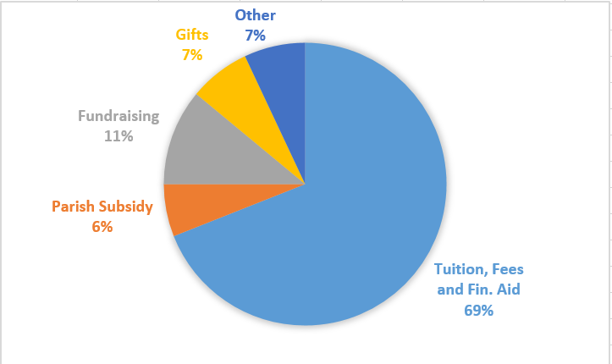
Operating Statement – Typical Revenue

Slide 17
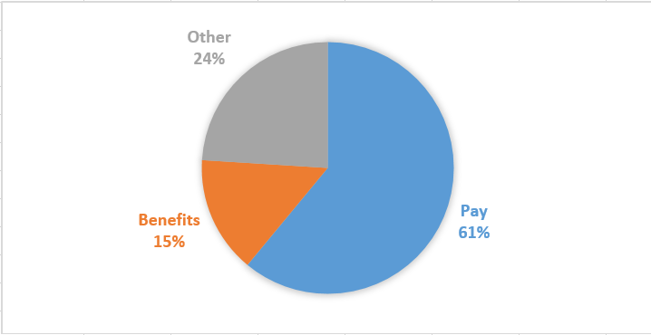
Operating Statement – Typical Expenses

Slide 18
How to Evaluate Your Operating Statement ?
Break down by Month
Compare to Budget
Compare to Prior Year
Compare through Metrics

Slide 19
Examples of Metrics
(Tuition, Fees & Aid)/(Salaries & Benefits)
2. Enrollment
3. Tuition, Fees & Aid/Student
4. Total Revenue/Student
5. Salaries & Benefits/Student
6. Total Expense/Student

Slide 20
Examples of what a Metric is telling us
(1) Tuition, Fees & Aid/Student has gone from $5,000 to $6,000
(2) Salaries & Benefits/Student has gone from $3,500 to $4,500

Slide 21
How do we look at Cash ?
Create a Monthly Plan
Beginning Cash
Cash out
Cash In
Ending Cash
Measure against the Plan

Slide 22
Why is Cash so Important ?
Cash Makes for Happy Employees
Cash Makes for Happy Vendors
Cash Makes for a Happy Pastor

Slide 23
What has Covid-19 done to Cash ?
Unique Sources
PPP Loan Forgiveness
EANS Funding
Fulcrum Grants
Developing a Plan

Slide 24
Balance Sheet Basics
Assets = Liabilities + Fund Balance

Slide 25
Balance Sheet - Assets
Assets – “What you own”
Cash
Unrestricted
Restricted – Donor
Investments
Endowment – 5% available annually
Buildings & Equipment

Slide 26
Balance Sheet - Liabilities
Liabilities – “What you owe”
Bills Payable
Custodial Funds
Loans

Slide 27
Balance Sheet – Fund Balance
The difference between what you own and what you owe

Slide 28
Questions
Let’s Stop and Discuss any Questions You Have So Far

Slide 29
III. School Budget - Participants
Who did last year’s?
What did we learn from last year’s Process ?
Who should drive the Budget ?
Revisit those Relationships

Slide 30
School Budget - Calendar
Start at deadline & work backwards
Reenrollment (Tuition) –Jan/Feb
Staff Commitment (Salaries) – March/April
End of Prior Year (Final Detail) – May/June
Start of School Year (Final Enroll) - Aug/Sep
Breakdown into Delegable Pieces

Slide 31
School Budget - Strategies
Review in advance with Key Participants
Expectations of Parish Budgeters
Address “what if’s” early
What if School ends up with a Surplus or Deficit ?

Slide 32
Poll #2 – Is there a Plan for Budget Surplus/Deficit ?
There is a plan
There is no plan
I do not know

Slide 33
Poll #3 – Bottom Line of Your School’s 21/22 Budget
Positive
Balanced (Zero)
Negative
I do not know

Slide 34
School Budget – Version Control
Create a trail of your work – versions
Document Assumptions and share
Keep your discipline to the end

Slide 35
School Budget - Reforecast
Part of the way into School year
Use months of Actuals to date
Use remaining months’ Budgets to end of year
Apply what you have learned about this year to those remaining budgeted months
Points to status at 6/30

Slide 36
School Budget – Multi-Year
Immediately after one year Budget
Use current assumptions while fresh
Solve issues that are too big for one year
First time reach for three years
Next time reach for five years
Cornerstone for next one year Budget
Major Item Assumptions – Enrollment, Tuition, Salaries
Lessor Item Assumptions – can be more blanket

Slide 37
Breakout Session
Share an Example of the hardest financial number you have successfully predicted and how you succeeded

Slide 38
Questions
Share one Budget Success shared in your group
One More Time Let’s Stop and Discuss any Questions You Have

Slide 39
Continuous Learning About Finance & Budget
Thank you for spending this time with us today.
Please consider us as resources you can contact any time going forward.
Remember – the only bad question is one that is not asked.

Slide 40
Contact Information
John Sullivan | Assist. Supt. for Financial Services
John.Sullivan@seattlearch.org
Office for Catholic Schools | Archdiocese of Seattle
O: 206-382-4860 | M: 206-702-4525
KELLY SURAPANENI | Coordinator of Leadership Development
Kelly.Surapaneni@seattlearch.org
Office for Catholic Schools | Archdiocese of Seattle
O: 206-382-4859 | M: 617-233-9993

Slide 41
HOW TO CLAIM CLOCK HOURS:
After the conclusion of the training, please claim clock hours by taking the following steps:
Please access pdEnroller online:
• Creating or Activating pdEnroller Teacher Accounts
All teachers and administrators should create their pdEnroller user account, if they do not already have one or have not activated it yet: https://www.pdenroller.org/welcome
• For instructions on how participants request clock hours with a claim code at the conclusion of an event,
click here.
Your Clock Hours Claim Code for Budgeting and Finance for Catholic School Leaders – February 11, 2022 is: STJ-H21
Clock hours earned through pdEnroller will be automatically uploaded to E-Certification!
Should questions arise regarding your claim for clock hours, please contact Lisa O’Leary
lisa.oleary@seattlearch.org
(206) 382-4843

