Slide 1
New Teacher Orientation
Justyna King – Assistant Superintendent of Academic Excellence

Slide 2
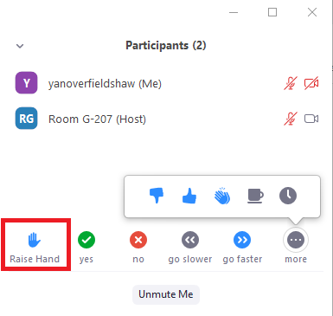
ZOOM meeting norms
Silence yourself (Keep on mute unless you mean to speak to the entire group)
Keep your video on (Unless you must step away or if you’re doing something weird. Don’t do anything weird.)
Change your name to the name you’d like to be called (not necessarily the email address you’re ZOOMing from)
Participate! ☺ (As much as you are comfortable doing so) – to do so, go into the “participants” tab and raise your hand!

Slide 3
Objectives for today
Understand the different supports within the OCS, Chancery and HR Departments
Understand the important policies, procedures, and best practices for teaching at the Archdiocese of Seattle
Familiarize yourself with the Archdiocese and fellow New Teachers and make connections with others on the same journey
Feel welcomed into the Archdiocese of Seattle!

Slide 4
AGENDA
Time: | Topic: | Presenter:
9:00-9:25am | Introductions and welcomes; prayer and overview | Justyna King, Assistant Superintendent for Academic Excellence
9:25-9:35am | Welcome to the Archdiocese and vision for our Catholic Schools | Nicholas Ford, Superintendent of Catholic Schools, Archdiocese of Seattle
9:35-9:45AM | BREAK OUT – meeting your cohort team members | BREAK OUT TEAMS
9:45-10:15am | Teaching best practices, Catholic School culture, opportunities, and programs, and finding your cohort | Justyna King and GRACE Regional Teacher Leaders & Kelly Surapaneni
10:15-10:25am | BREAK OUT II – discussing details, questions that remain | BREAK OUT TEAMS
10:25am-10:45am | Think and Ink – What makes a good teacher great? | What makes a good teacher great? | Azul Terronez | TEDxSantoDomingo – YouTube Or The Power of a Teacher | Adam Saenz | TEDxYale - YouTube
10:45-11:00AM | BREAK
11:00-11:10AM | Safe Environment – requirements and how to get SET Trainings | Courtney Wright, Safe Environment Coordinator
11:10-11:45am | Policy Manual and understanding your new role in Catholic schools | Pam Schwartz, Assistant Superintendent for Personnel
11:45-11:59am | Final Reflections and important contacts / end of meeting survey | Justyna King, Assistant Superintendent for Academic Excellence

Slide 5
Prayer/Thoughts for Beginning the new school year:
Every student needs a champion: every student needs a champion
Dear Lord –
Please remind us that every child needs a champion. As educators, we strive to hold our students to the highest standards but remind us that those standards should always encompass the ideals of your wisdom – every child is made in the likeness of God and is loved. This love cannot be earned – it cannot be taken away. It is always there because each one of us is a child of God. Remind us to lead with love and not with cynicism, lead with kindness and not with fear, and lead with compassion not with frustration. Teachers are the most impactful disciples of your Catholic Church and remind us to always lead with love because every child deserves a champion.
AMEN

Slide 6
Superintendent’s Message

Slide 7
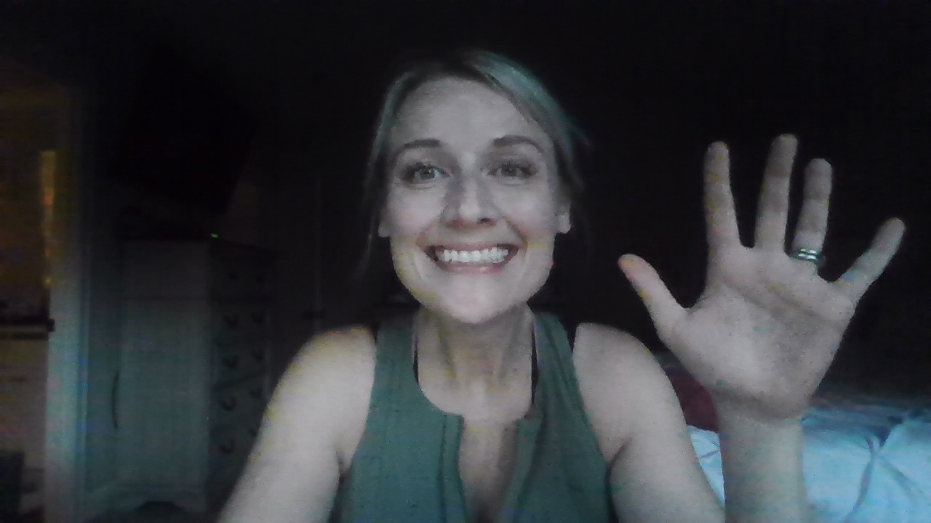
Academic Excellence
Curriculum and Instruction
Accreditation – WCEA
Assessments – NWEA and MAP testing
Professional Development – Curriculum and PD Day (virtual) – 02/10/2023
GRACE – Guiding Regionally-Advancing Catholic Education program
NSBECS – National Standards and Benchmarks for Catholic Elementary and Secondary Schools
Evaluation systems and teacher support programming
New Teacher Orientations / Induction Program help (IP)

Slide 8
Facts about our Archdiocese
11 High Schools
60 Elementary Schools
1 Early Learning Center
Geographically spans north to the border of Canada, east to the mountains, south to the border of Oregon and west to the coastline of WA state.

Slide 9
High Schools
Archbishop Murphy (Everett)
Bishop Blanchet High School (North Seattle)
O’Dea High School (Seattle)
Seattle Preparatory (Seattle)
Holy Names (Seattle)
Eastside Catholic 6-12 (Sammamish)
Forest Ridge 5-12 (Bellevue)
Kennedy Catholic HS (Burien)
Bellarmine High School (Tacoma)
John Paul II High School (Lacey)
Seton Catholic High School (Vancouver)

Slide 10
60 Elementary Schools
9 Regions
Eastside
Northern
Olympic
North Seattle
Pierce
South Seattle
South King
Southern
South Sound

Slide 11
NSBECS – what are they?
The National Standards and Benchmarks for Effective Catholic Elementary and Secondary Schools (NSBECS) were published in 2012 to serve as both a guide and assessment tool for PK-12 Catholic school effectiveness and sustainability. They include research-based school effectiveness criteria, as well as criteria unique to Catholic school mission and identity. The NSBECS rests on the conviction that adhering to these standards and benchmarks with fidelity will result in highly effective Catholic schools.

Slide 12
The Four Domains
Mission & Catholic Identity
Governance & Leadership
Academic Excellence
Operational Vitality

Slide 13
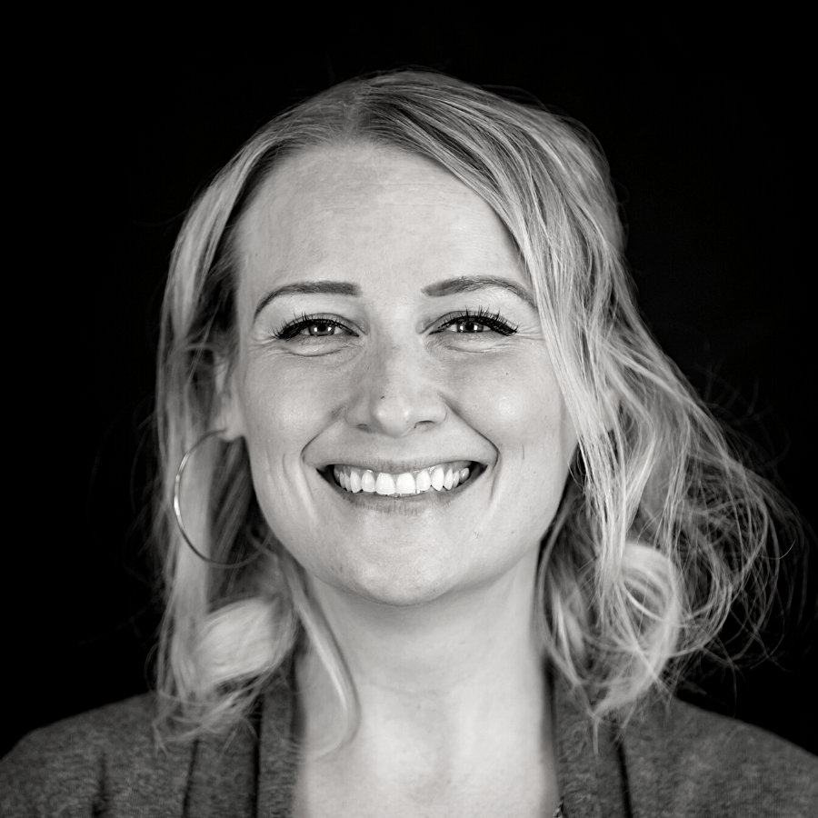
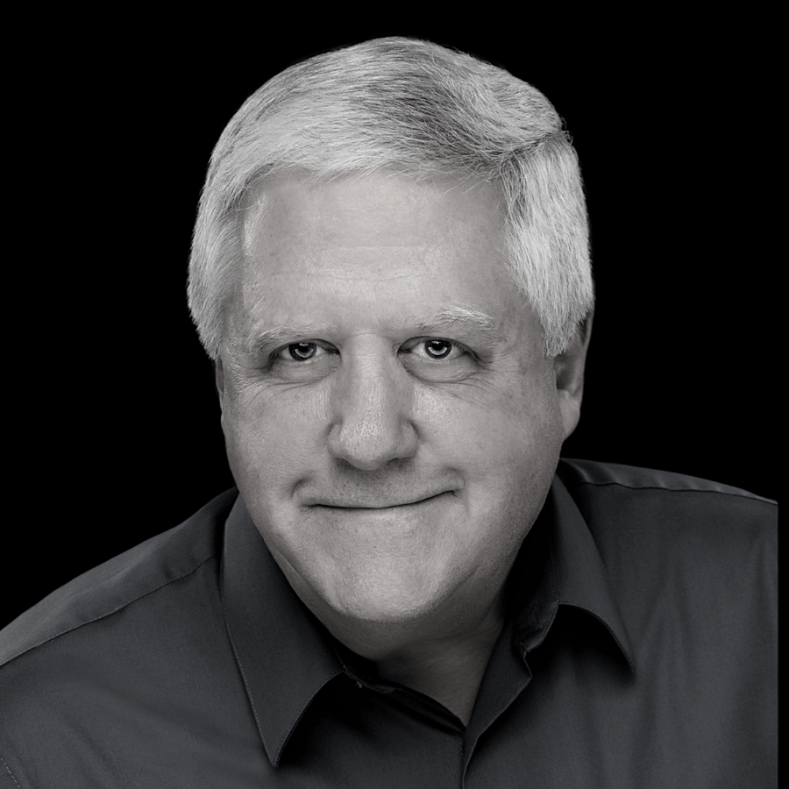
The Four Domains Align with OCS
Mission & Catholic Identity
Governance & Leadership
Academic Excellence
Operational Vitality
Connor Geraghty- Assistant Superintendent for Mission and Catholic Identity
Pam Schwartz– Assistant Superintendent for Governance and Leadership
Justyna King – Assistant Superintendent for Academic Excellence
John Sullivan – Assistant Superintendent for Finance Services

Slide 14
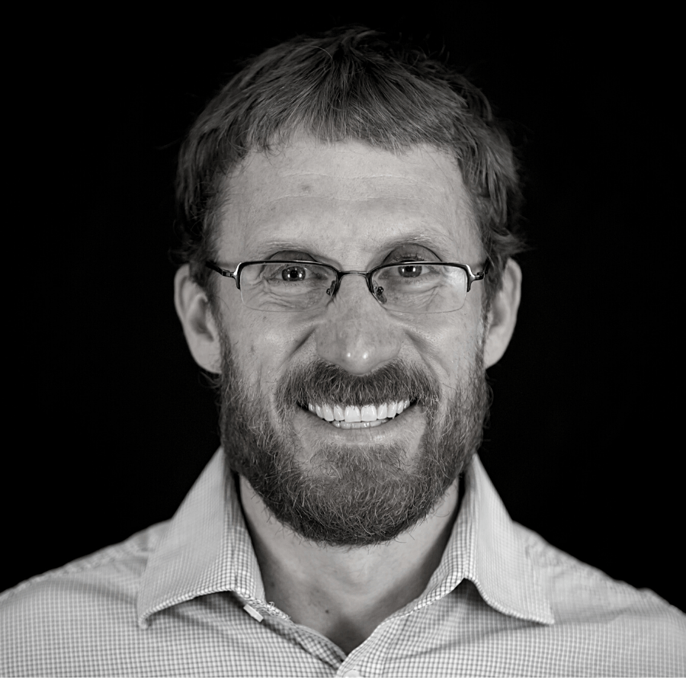
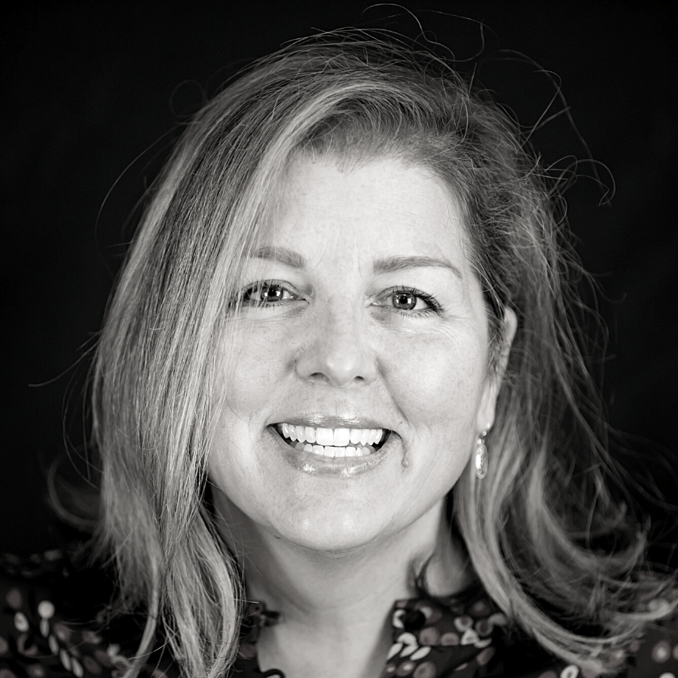
Leadership at the Office for Catholic Schools cont.
Dave Mayer – Director of Early Childhood Programs
Kelly Surapaneni – Coordinator of Leadership Development
Kristin Moore – Director of Marketing & Enrollment

Slide 15
GRACE Teacher Leaders
These are teacher leaders in your school trained in:
MAP Testing Data collection and PLC structure to use the data for student improvement
Curriculum development and alignment
CEL 5D and Peer Observations – teacher evaluation systems
NSBECS familiarization and accreditation protocols
Professional Learning Communities
Critical Friends Group protocol* (sharing in problems of practice) – starting in 2022-23

Slide 16
Breakout Room Part I:
Introduce yourself
What school you are representing
What are you teaching
Why you took your position at your particular Catholic school

Slide 17
Best Practices for Teaching at Your Catholic School

Slide 18
Best Practices in Catholic Schools
Always start with a prayer –it sets the tone and it centers learning around prayerfulness
Learn about the Catholic Faith – how does it align to your teaching? How does it align with Catholic Social Teaching? – Christ in the Classroom, etc.
Attend and participate in retreats, liturgies, archdiocesan trainings and events (PD & Curriculum Day February 10th 2023)

Slide 19
Best Practices in Catholic Schools
Learn about the liturgy – what is your role and how can you actively participate?
Get to know your school pastor/priest – invite him into your classroom
Learn about your community and the family helpers around – which moms/dads/friends are the helpers?

Slide 20
Best Practices in Catholic Schools
Be helpful, but don’t take on too much in your first year at a new school
Get feedback from your principal, department chair or GRACE TL on your syllabus – make sure it aligns to your school’s mission and values
Familiarize yourself with the school calendar – there are special times/celebrations (Catholic Schools Week, Holy Days of Obligation, Holidays)
Read your covenant and family handbook – aligning expectations

Slide 22
Breakout Room Part II:
Introduce yourself (again)
What school you are representing (again)
What are you teaching (again)
Given these best practices, will I be re-evaluating anything in my professional practice?
Questions that remain? Surprises? Interesting points of discussion?

Slide 23
Think & Ink: What Makes a Good Teacher Great??
Take notes as you watch this
What makes a good teacher great? | Azul Terronez | TEDxSantoDomingo – YouTube
The Power of a Teacher | Adam Saenz | TEDxYale - YouTube
Every Opportunity - Bing video

Slide 24
Find your marigold teacher
Find Your Marigold: The One Essential Rule for New Teachers | Cult of Pedagogy

Slide 25
Advice for new teachers … from teaching veterans who have been in our Archdiocese
Ask questions! Even if you’re shy or don’t want to come across as dumb. It’s not dumb to be new.
Read your handbook. Ask questions about it. Refer back to it.
Clean up your social media. Some parents scroll back through posts from years ago.
Ask about the culture differences between this environment and what you are coming from - living a Catholic lifestyle is in your covenant.
If it takes more than three sentences to explain, just call! (Unless there’s a compelling reason to have documentation - but even then, call and take notes)
Don’t respond to emails immediately. During the school day your job is to be present to the students. After 5pm/on the weekends you have a life outside of school. Set the precedent early in the year and stick to it.
Have a trusted mentor teacher read over any email you aren’t sure about before you hit send.
Mornings are crunch time… try to save big questions for a more convenient time. Don’t hesitate to ask when a more convenient time is!
When in doubt, dress nicer than you think you need to.
Keep a record of lesson plans and homework assignments. This might come in handy during meetings with parents.
Over-communicate & keep your families informed (weekly newsletters/emails, websites up-to-date, homework & other assignments, etc.). This cuts down on the number of emails worried parents send, especially if you can point to them often in the first weeks of school. These can be used as marketing tools too.
If you have difficult interactions with students/families, consult with other staff members to see if they experienced similar challenges. They might have background knowledge that you are unaware of.
Make connections with the specialists. They are helping to support your units and want to partner with you in the best way possible for the success of your students.
Make connections with the facilities people and office staff. Become friends with them and stay friendly even when you are stressed - you will need their support often.

Slide 26
BREAK

Slide 27
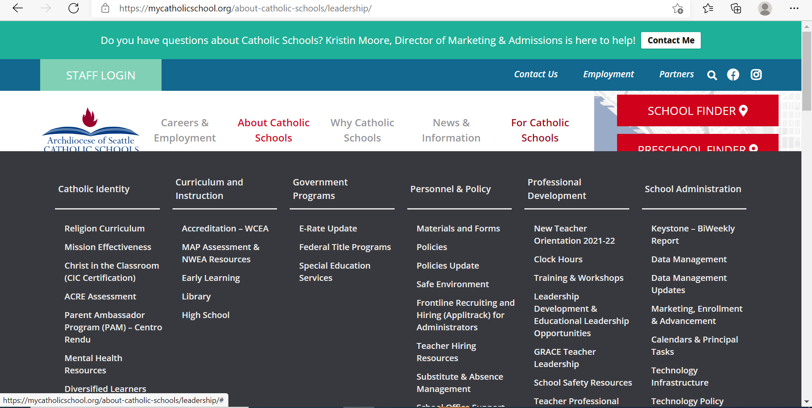
Safe Environment Training
Courtney Wright

Slide 29
Policies and Procedures
Pam Schwartz
Assistant Superintendent,
Personnel & Leadership Development
Pam.schwartz@seattlearch.org
206-790-1925
Notes:
Introduce myself & my role

Slide 30
Mission Statement…
Catholic schools in the Archdiocese of Seattle have a long tradition of academic excellence that is firmly rooted in the Gospel of Jesus Christ. From preschool through 12th grade, students are prepared for success in college, life, and beyond. Catholic schools are communities where educators and families effectively partner to ensure the development of the “Whole Child”: Mind, Body, and Spirit.
Notes:
As a teacher, YOU are the foundation of our schools…second only to Jesus himself. What you do everyday is nothing less than shape lives – Here in the Catholic schools, your impact goes well beyond shaping just your students’ minds, as is reflected in the words of our mission statement shown here. In part it reads…
The whole child…mind, body, and spirit…that’s a big job!

Slide 31
Ministerial Covenant
A covenant is “a solemn agreement between human beings or between God and human beings involving mutual commitment or guarantees” (CCC, p. 873). The relationship between God and human beings has been revealed through covenants that are foundational to the core beliefs in the history of the Judeo-Christian tradition. Similarly, the relationship between the Church and those employed by the Church is covenantal rather than contractual and gives rise to various rights and obligations for employees serving in the parish/school in any capacity.
Notes:
You may have noticed that when you signed your ‘contract’ with your school, it wasn’t entitled as such. Here in the Archdiocese of Seattle, we refer to them not as employment contracts, but as Ministerial Covenants, and that is for a very intentional reason. As the title suggests, teaching in a Catholic school is more than just a job, it is a ministry. A ministry to God who calls us to this very important role – through our teaching we serve not only our students, but we serve God as well. As is explained in the Archdiocesan Employee Policy Manual…(read)
I share all this with you to help frame your role and emphasize the importance you have in your schools and classrooms. We are grateful that you have said YES to this calling!

Slide 32
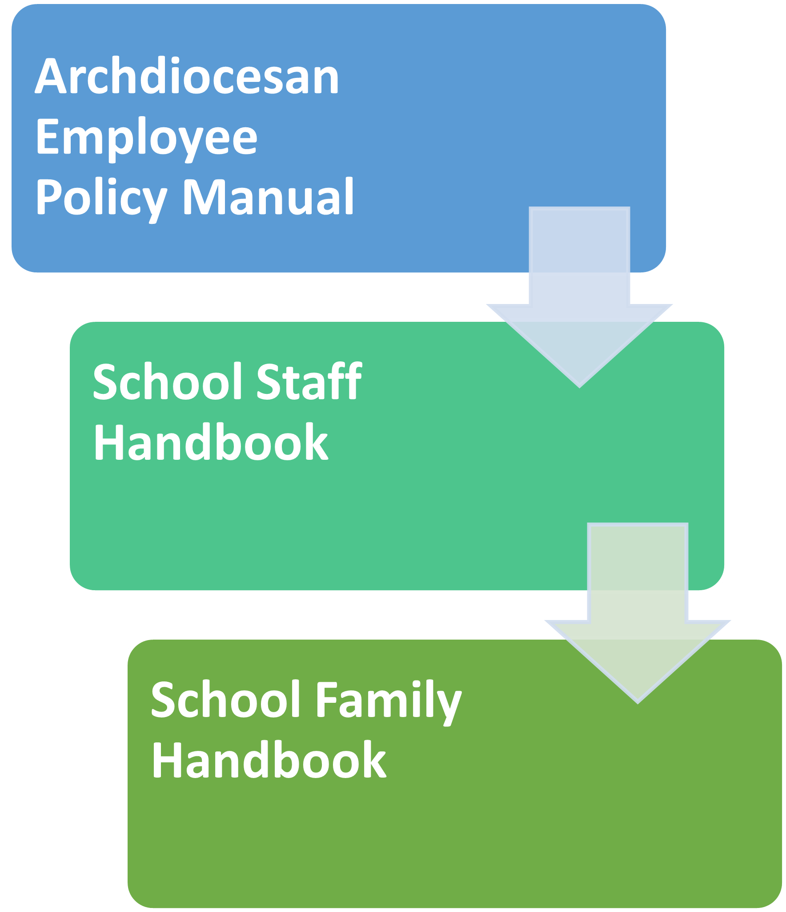
Policies & Procedures
Notes:
Our policies and procedures are there to guide and support you. There are 3 levels of policies that you should be familiar with. First is the Archdiocesan Employee Policy Manual – this is really the Grand Daddy of them all (kind of like one ring to rule them all). The Policy Manual is universal and it outlines policies that apply to all Archdiocesan schools and employees (the only exception is if you are in a Category II High School (these are not Archdiocesan schools but are owned and operated by a separate governing board…AMHS, Seattle Prep, HNA, they have their own specific Employee Policy Manuals - so they will have differences but there will be similarities so this is still helpful info for those folks). For all other schools, the Archdiocesan Employee Policy Manual applies. All employees are required to read the policy manual, then sign and return the acknowledgement page to your principal.
2. From the Policy Manual comes the School Staff Handbook. There are some policies and procedures that are universal to all schools, but there are also things specific to your particular school.
3. The third set of policies is found in the family handbook, which is very specific to your school.
Your principal should give you a copy of each. It’s very important that you read each thoroughly and sign/return the acknowledgement. If you don’t receive a copy, please ask for it. Why???

Slide 33
Purpose of the Employee Policy Manual
An employee manual is to document an organization’s expectations for employees and what employees can expect from the organization. In other words, it states our legal obligations as an employer and rights as employees. It contains important information on the organization’s policies and procedures and has all details that employees would need to know about their workplace.
Notes:
Because you want to know what expectations you will be held to by the school and Archdiocese. This slide explains further – this explanation also applies to both the policy manual AND your school’s staff handbook…(Read)

Slide 34
Key Employee Policies to Note
Code of Conduct
Observations/Performance Reviews
Parent Communications
Confidentiality
Current WA State Teaching Certificate
Maintaining Safety in the Workplace
Safe Environment Course & Background Check
Internet, Email, Social Media
Teacher/Student Interactions
Student Supervision
Mandatory Reporting Requirements (see handout)
Notes:
Again, it’s important that you read the complete Policy Manual, but I’d like to highlight some key things you should pay close attention to.
Code of Conduct: “School employees should conduct themselves in a professional and business-like manner, treating co-workers, clergy, parishioners, parents, students, and others with respect. They must conduct themselves in a moral and ethical manner consistent with Catholic principles in the performance of work duties and live a lifestyle compatible with Catholic teaching.” This can be a lightening rod at times…that’s another conversation for another day, but you do need to know that as an employee of the church, your actions both in and outside of school are important. You don’t want to do or say something that can be seen as contrary to church teachings, or derogatory to the school/church/administration. That includes your social media posts – Justyna will be talking more about that I believe, but in short, this standard is different than public schools and you should be aware of those expectations.
Performance Reviews: Principals are required to observe new teachers twice within the first year of a new assignment (once in first 60 days and then again before May 15). Your principal should review your evaluation with you and provide a copy for your records.
Parent Communications: I think you will find our parents to be very supportive and positive overall. They tend to be very involved and interested in what’s going on in the classroom. The more communication you can provide proactively, the better. Keep them informed about what you are teaching and classroom events. If their child is struggling, reach out to them early on. Don’t let report card time be the first they hear of any academic or behavior issues. Be kind and respectful – which I know can be difficult sometimes when they are coming at you. Always try to remember that their intentions are good. Avoid getting defensive and stick to the facts. If you get a long and detailed email – call them instead of responding via email. Tone can easily get misinterpreted over email. Communicate the positive, not just the negative – it goes a long way. Reach out to your principal for help if you aren’t sure how to respond.
Confidentiality is critical – on all levels.
Be sure you know what’s expected of you to maintain a safe classroom and school:
Complete your safe environment course and subsequent updates
Remember that your school issued computer devices and your school email are the property of the school, and should be used in accordance with those policies.
Interactions with students: Should always be professional and respectful. Do not communicate with a student via text, personal phone, or social media. If you need to communicate via email, copy a parent on it. Blogs should only academic in nature, and public/advertised to parents and your principal (check with him/her first before initiating). In person 1-1 interactions with students: Always meet in a public place, never behind closed doors. If it needs to be a closed-door conversation, have someone else present. Avoid physical contact. Side hugs, handshakes. Never drive a student in your car (for both personal safety reasons and liability).
Mandatory Reporting Requirements (review document) If you have reason to suspect any sort of abuse (physical, sexual, neglect), you are obligated to report it to CPS within 48 hours of becoming aware of a possible situation. Not your obligation to determine if it’s true or to obtain proof. Rule of thumb: If you aren’t sure if you should call, error on the side of caution – CALL! Your principal can call for you, but YOU need to ensure that the call was made (follow up on it) – CPS will likely want to interview you to find out what you know. Teacher concerns…parent will know, what if I’m wrong?
Need a current WA state teaching certificate (there are a few exceptions, consult with your principal) or a certificate to sub and working on a permanent one. Keep it current, don’t let it lapse. Provide a copy.

Slide 35
Purpose of Family Handbook
A Family Handbook is to document the school’s policies, expectations and responsibilities for families (parents and students) and explains what families can expect from the school. In other words, it is the first line of communications and states our position as a school and the rights of both the school and families. It contains important information on the schools policies and procedures and has all the details that families would need to know about their participation and membership.
A Family Handbook plays a critical role providing clarification and consistency of interpretation of policies and procedures, preventing misunderstandings, reduces complaints and challenges.
Notes:
Read

Slide 36
Other Important Info. to Know
Expectations
Attendance: Arrival/Departure Times, Absence Requests
Staff Meetings, In-Service Days, Special Events
Other Duties (Recess, Carpool, Lunch, etc.)
Safety Procedures (Fire, Earthquake, Lockdown, Building Security, Inclement Weather, COVID Plan, etc.)
COVID Policy/Procedures (upload proof of vaccination to CLUE app in Paycom)
Discipline Policy
Grading Policy
Uniform/Dress Code
Field Trip Procedures
Archdiocesan Permission Form Required
Parent Drivers (Required: Background Checks & Safe Environment)
Car Seats (if applicable)
Notes:
The following should be outlined in your staff and family handbooks – if not, ask your principal (read)

Slide 37
If you run into a snag…
Talk to your principal – he/she should be your first go-to person
Contact me – I’m here to help!
Pam Schwartz
Asst. Superintendent for Personnel & Leadership Development
pam.schwartz@seattlearch.org
Notes:
First go to person should be your principal. In most situations, he/she can help you through it. If the event that you should have a conflict with your principal that you’ve tried to work through with him/her, but need some support – I’m here for you. All conversations will be confidential, but I may ask for permission to speak with your principal to keep more information, but you are not required to give me permission. The only time I cannot guarantee confidentiality is if what you tell me is illegal or may result in harm to someone.

Slide 38
February 10th, 2023

Slide 39
Need anything?
Email me whenever – justyna.king@seattlearch.org or (206) 245-9174
Register for mycatholicschool.org and find resources there that you need
Read through your Policy Manual and your Family Handbook – flag high touch points and reference them often.

Slide 40
.
HOW TO CLAIM CLOCK HOURS:
Go to pdEnroller online:
All teachers and administrators should create their pdEnroller user account, if they do not already have one or have not activated it yet. Please click on the following link to find pdEnroller Onboarding Process
Instructions: https://www.pdenroller.org/welcome
For instructions on how participants request clock hours with a claim code at the conclusion of an event, click here
High School NTO on 8/10/2022: Clock Hour Claim Code: 4CQ-HKG
Elementary School NTO on 8/11/2022: Clock Hour Claim Code: L2A-4ON
Clock hours earned through pdEnroller will be automatically uploaded to E-Certification!
For instructions on how to print an official transcript for clock hours earned through pdEnroller, click here.
Should questions arise on your clock hours proposal, please contact Lisa O’Leary at lisa.oleary@seattlearch.org or by calling (206) 382-4843

Slide 41
Questions?

