Slide 1
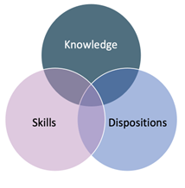


The Big 3 of SLD
Dyscalculia, Dysgraphia, Dyslexia
Presented by
Sue Milano
February 7, 2025
ArchDiocese of Seattle
Catholic Schools
Copyright © 2024 by Inclusion Solutions LLC

Slide 2
Opening Prayer
Lord God, your spirit of wisdom fills the earth and teaches us your ways.
Look upon these teachers. Let them strive to share their knowledge with gentle patience and endeavor always to bring the truth to eager minds.
Grant that they may follow Jesus Christ, the way, the truth, and the life, forever and ever.
Amen.

Slide 3
Housekeeping
Expectations: Cameras on; participate; use the chat
Must use your legal name when signing in – cannot verify if not using your full name
Record these sessions
5 minute breaks on the hour

Slide 4
Expected Outcomes
Participants will learn the components of Dyscalculia, Dysgraphia, and Dyslexia
Participants will attain practical strategies and accommodations to use in their classrooms

Slide 5

It’s all Greek to Me!
“dys” = difficult, impairment
Dysgraphia
“dys” + “Graph”
difficulty with writing
Motor & Language
Dyscalculia
“dys” + “calc” (Latin)
difficulty with numbers or calculations
Visual
Dyslexia
“dys” + “Lex”
difficulty with words
Auditory
It’s All Neurological!!
Notes:
.

Slide 6
Time to Participate!
Raise your “virtual hand” if you have heard of Dyslexia
Raise your “virtual hand” if you have taken a training, workshop, webinar on Dyslexia
Raise your “virtual hand” if you have heard of Dyscalculia
Raise your “virtual hand” if you have taken a training, workshop, webinar on Dyscalculia
What conclusions can you draw from that?

Slide 7
“Difficulty in mathematics as a result of impairment to particular parts of the brain involved in mathematical function, without a general difficulty in cognitive function”
Manifests in difficulties with
number sense,
operations,
fluency, and
word problems
Dyscalculia
How do you say it?

Slide 8
Innate Number Systems
Approximate
Number Systems
Subitizing
visual processing part of the brain
being able to “see” numbers
being able to see quantity/magnitude
more/less
estimating
Panamath
Notes:
There are certain skills we are born with. The ability to see color (not the word for the color, just the color itself) We are also born with the ability to “see” small groups of numbers – up to usually 4. This is called subitizing. We are also born with the ability to see quantity and magnitude. Children with Dyscalculia have impairments in either their ability to subitize or quantify.
Ask for a volunteer to try Panamath

Slide 9
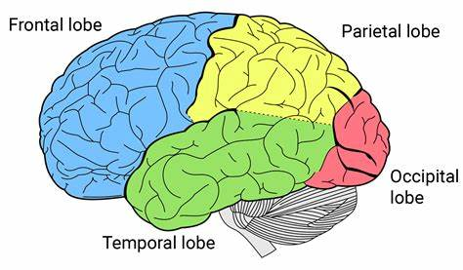
Notes:
There are 3 main brain areas that would be responsible for a student’s ability to perform in math.
1 – Prefrontal Cortex – executive functioning deficits - can they hold information in their working memory or follow multi step problems
2 – Temporal Lobe – language – word problems, understanding the vocabulary behind mathematics
3 - Parietal Lobe – visual processing – this is your number sense lobe where subitizing and quantifying take place
For today’s purposes and the interest of time, we are focusing on number sense.
How many ways can you represent “three”

Slide 10
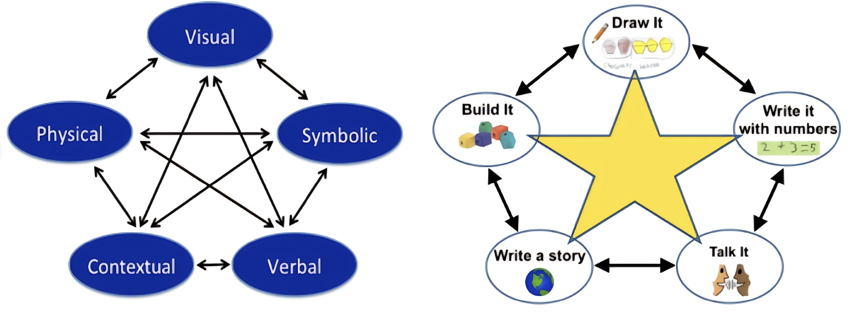

Image from Mastering Math Manipulatives Image from School District of Waukesha
Notes:
Kim Rimbey – 3 classes in the one week! Using manipulatives in BTC, Making math accessible for neurodivergent learners, and Math Fact Fluency. She uses these visuals to represent the different pathways for math, demonstrating the interdependency on each other. Notably not linear or sequential. But I would say that the visual strand needs to be intact before the symbolic to help solidify number sense.

Slide 11
Dyscalculia
Dyslexia
Difficulties with the innate NUMBER system
Deficit in ability to SUBITIZE
Affects
Visual Processing
Difficulties with the innate LANGUAGE system
Deficit in PHONOLOGICAL AWARENESS
Affects
Auditory Processing
Neurological
Difficulty with memorization
Concept Mapping
Notes:
Dyscalculia is the stepchild of Dyslexia

Slide 12


Decomposing
Recomposing
Dot Cards
Cuisenaire Rods
Tiny
Polka Dot
Visual Cluster Cards
Number Balance
Rekenrek
Notes:
One concept that we need to understand is decomposing/recomposing – taking apart and putting back together. Intentionally listed with decomposing first because we want to start with the WHOLE and move to the parts. Picture a bicycle in your mind. Now picture the bicycle without 2 wheels. Alternatively, picture a bicycle wheel. Now picture what you would need to create the bicycle. Which was easier? This is why we prefer directions in pictures. Think IKEA! Could you imagine having all the parts but not a picture of the whole?
In the area of math instruction, the “part” is counting, the “whole” is subitizing! We build pictures first, then we count. We want to move students from overreliance on counting to the ability to “see” numbers and generalize them.
When we are building number sense, we Decompose and recompose numbers. If you are like me, we didn’t say these words when we were taught math. We did say adding and subtracting. And when we couldn’t subtract 9 from 23, we had to “borrow”. But we aren’t borrowing – we are decomposing and recomposing numbers. It’s just a different representation of the original number. We can teach students at a very early age to decompose and recompose. You might know this as “making 10”. Since we live in a base 10 world, the ability to make 10 visually, then symbolically, is the foundation for all other math learning.

Slide 13

Word Problems
Attack Strategies
easy to follow steps to complete a problem
(RUN: Read, Underline, Name)
Schema Instruction
Addition/Subtraction
Combine
Compare
Change
Multiplication/Division:
Equal Groups
Comparison
Proportion/Ratio
Notes:
Find examples of schema instruction!
Combine – there are 10 bluejays and 5 cardinals – how many birds? There are 15 cardinals and 5 flew away – how many are left?
Compare – Jack made $20 mowing lawns and Halie made $25 babysitting. How much more did Halie make? OR Halie made $5 more than Jack. If Jack made $20, how much did Halie make?
Change – Jack went shopping with his $20 and he went home with $7. How much did he spend at the store? OR Halie started with $25 and spent $10, how much does she have left?
Multiplication
Equal Groups - There are 10 students who each have 3 pencils. How many pencils? OR There are 30 pencils to be shared among 10 students – how many would each receive?
Comparison – Teachers in Minnesota make 3 times as much as teachers in Arizona. If Arizona teachers make $30,000, how much do Minnesota teachers make?
Proportion/Ratio – Jack mowed 2 lawns in 3 hours. How many lawns could he mow in 6 hours?

Slide 14
Addition and Subtraction
In the chat, give an example of a “Combining” word problem
In the chat, give an example of a “Comparing” word problem
In the chat, give an example of a “Change” word problem
Multiplication and Division
In the chat, give an example of a “Equal groups” word problem
In the chat, give an example of a “Comparing” word problem
In the chat, give an example of a “Proportion” word problem

Slide 15

What are your goals for your students as a math teacher?
Problem solvers
Self confidence
Notes:
Partner share – what are your goals for your students as a math teacher? Ask for some input
Introduce the new book from Rachel Lambert. She interviews different teachers and what really resonated with me is that overwhelmingly teachers said they wanted students to be problem solvers and have self confidence in their math abilities. How do we do that? We have to really think about the way we design our instruction.

Slide 16
“Radical” because the problem is situated with the design and not the student
“Every child has the right to make sense of math and use it in their world.”
Roles
Teacher as Designer
Student as Problem Solver
“We have created deficit mythologies”
Radical Shift in Mathematics Instruction
Notes:
Building Thinking Classrooms – discuss how guided inquiry is helping students become problem solvers – higher engagement in their learning. Moving away from robotic regurgitating to collaborative learning.
Reframe from a deficit to an asset model
Challenge the linear! Math can be visual, creative, collaborative

Slide 17

Universal Design for Learning
Action & Expression
Engagement
Representation
Meaningful
Supportive Environment
Equitable Feedback
Self as Math Learner
Multimodal
Investing in Core Ideas
Notes:
Show hand gestures!
1 – classrooms with barriers, narrow view of how to teach math
2- open the classroom
3- provide strategic supports
Goal of UDL is to create expert strategic thinkers
Talk about what I previously thought Engagement and Representation meant. Now I understand that Engagement is really how students connect with the content. It’s a relationship!
Meaningful = collaborative, problem solving, engaging, interesting relevant
Supportive environment – reduce the anxiety! Relieve pressure. Reframe math as a process not a race. IT’s about thinking not speed. Students need to feel safe to explore and take risks.
Representation – used to think that was all on the teacher to represent the content in multiple ways, but also about representing math in multiple ways
Multimodal – different ways to see math – pictures, words, equations, hands on
Core Ideas – teachers feeling like there’s not enough time; idea of investing in the core ideas and prioritizing practice for those. Connect topics. Focus on number sense and place value
Action and Expression –
Equitable feedback – assessments need to match what the students know – timed tests don’t accomplish this
Self as a Math learner – metacognition, choice! Never make students show proficiency in all strategies. Figure out what works for them

Slide 18


Visual Spatial
Spelling
What
is Dysgraphia??
Lack of consensus
Fine Motor
Language
Processing
Executive Functioning
Notes:
Handwriting Improvement: Strengthening hand muscles through activities like playing with clay, keeping lines within mazes, connecting dots or dashes, tracing letters, imitating teacher modeling, and copying letters from models​ (Dyslexia IDA)​​ (IDA Branch)​​ (Understood)​.
Developing Automatic Letter Writing: Using steps to practice each letter, studying numbered arrow cues, imaging letters in the mind’s eye, writing letters from memory, and writing letters from dictation​ (Dyslexia IDA)​​ (IDA Branch)​.
Spelling Instruction: Initially focusing on high-frequency Anglo-Saxon words and subsequently coordinating phonological, orthographic, and morphological processes for more complex words​ (Dyslexia IDA)​​ (IDA Branch)​.
Composition Strategies: Planning, generating, reviewing/evaluating, and revising compositions of different genres, and employing self-regulation strategies for managing complex executive functions involved in composing​ (IDA Branch)​​ (Understood)​.

Slide 19
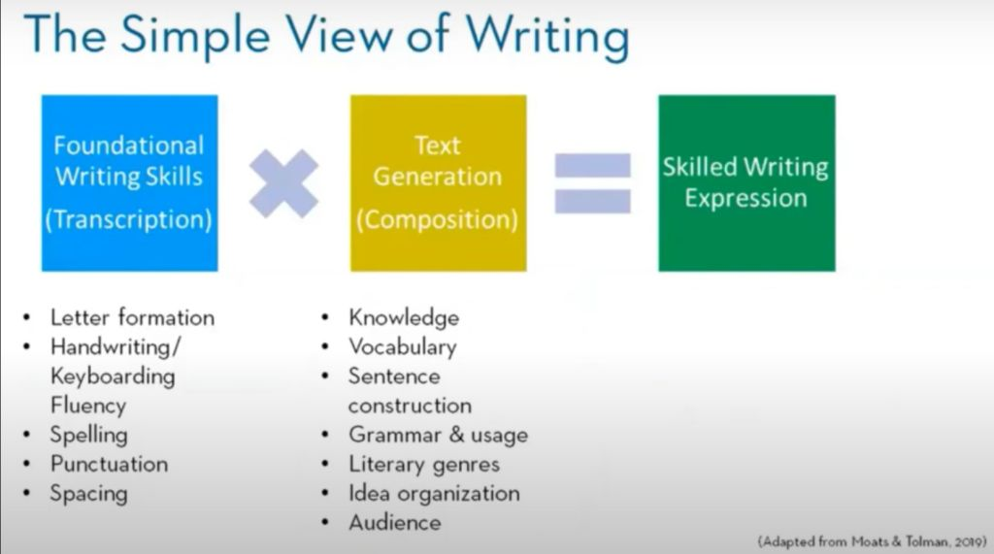

Slide 20
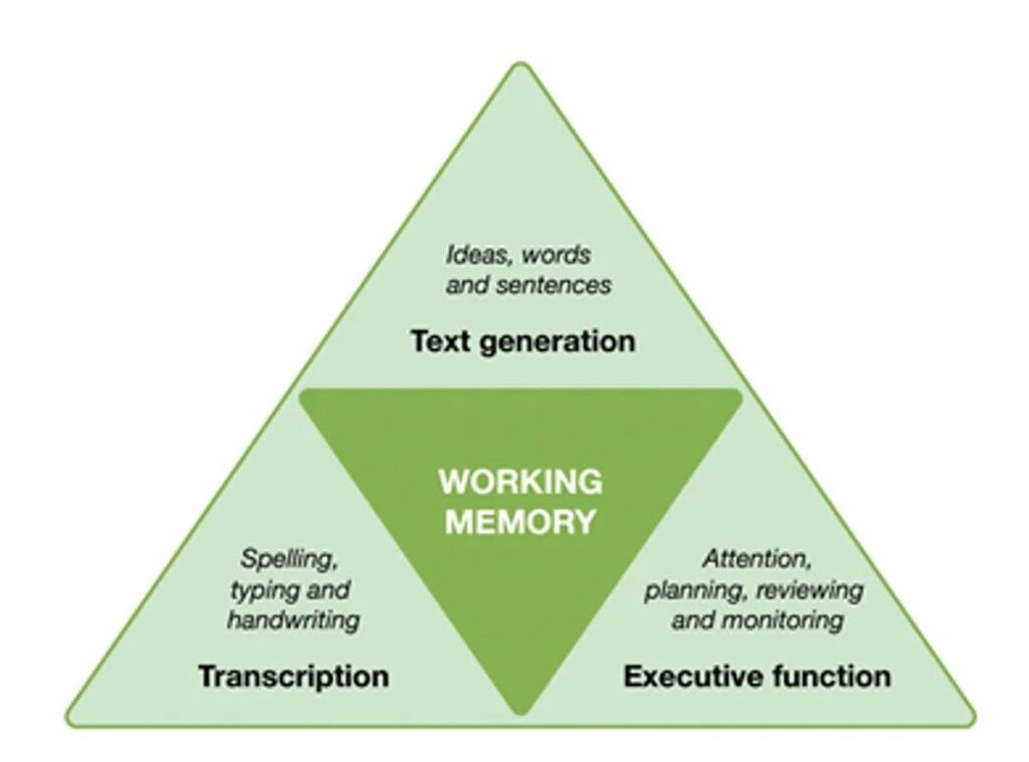
“The Not-So Simple View of Writing”

Slide 21
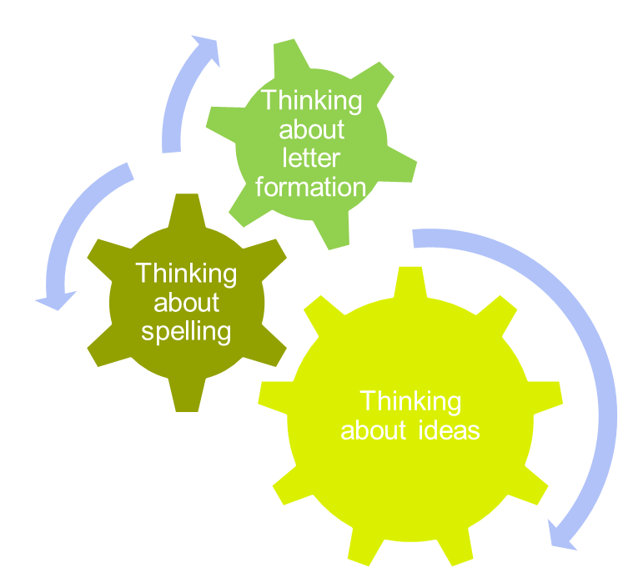
Impact on Fluency and Motivation

Slide 22

Skill Building vs Accommodations
Skill Building
Accommodations
Identify the area of need
Implement strategic activities to strengthen
Not
either/or
It’s BOTH/AND
Increases fluency
Levels the playing field
More time

Slide 23

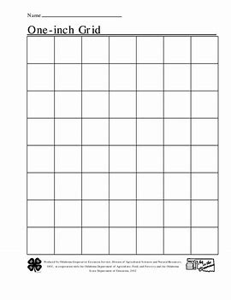

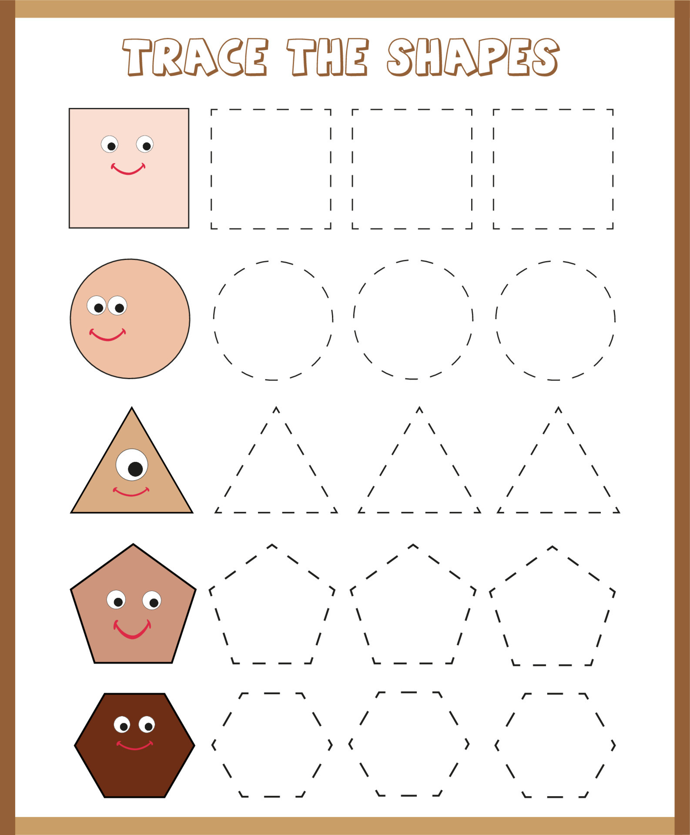
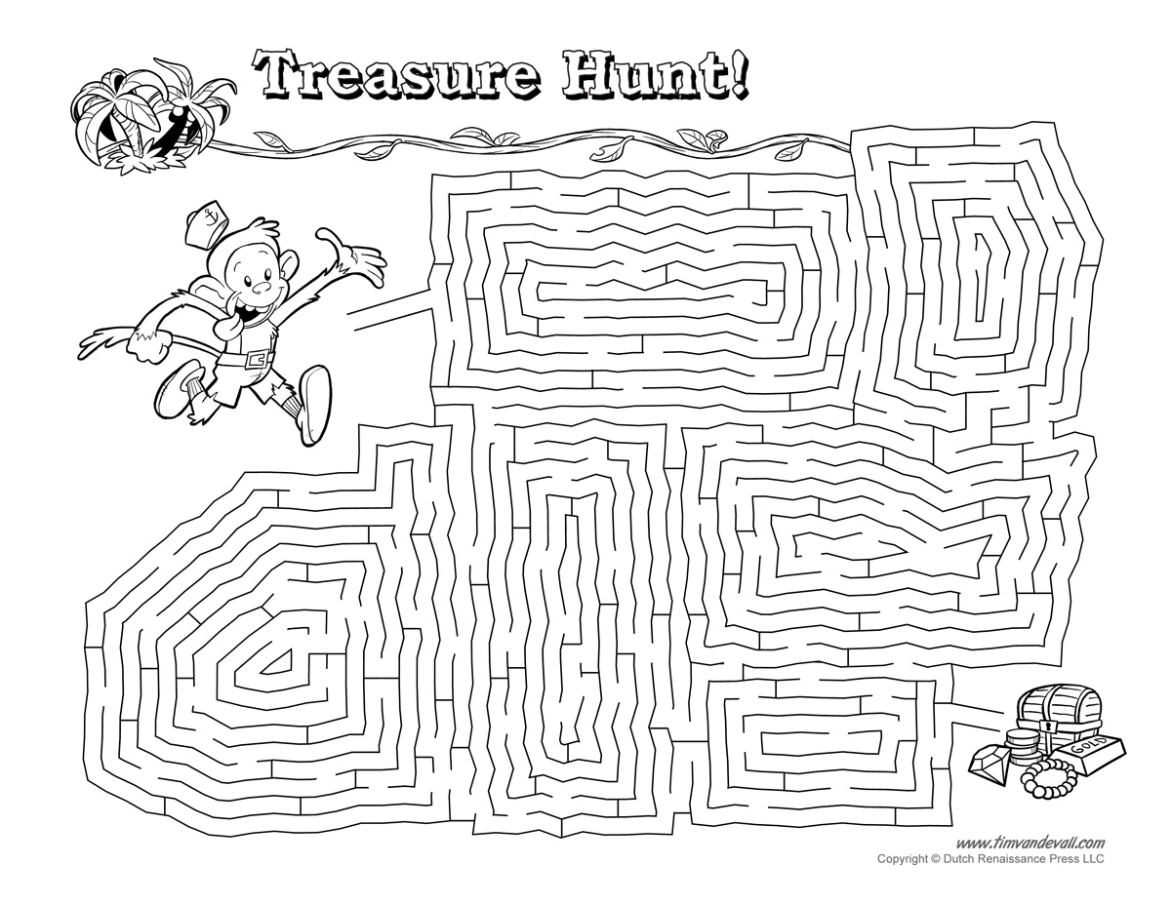
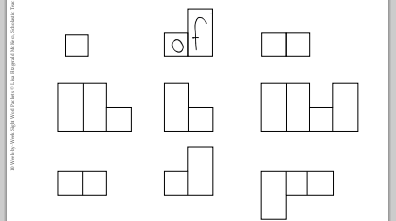
Visual Spatial Deficits
Skill Builders
Mazes
Dot to dot
Air writing
Tracing
Accommodations
Raised line paper
Graph/grid paper
Visual models
Guided boxes
Highlighter strips

Slide 24
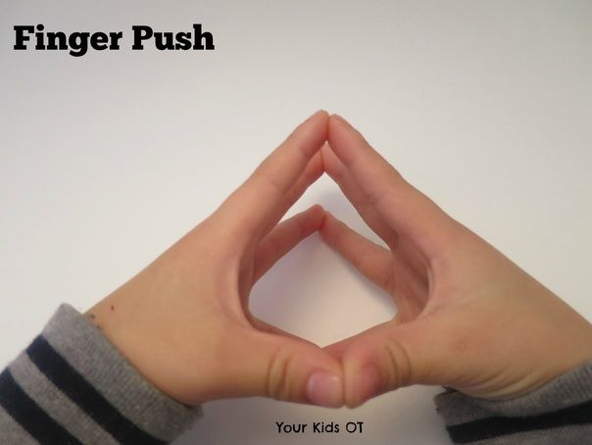
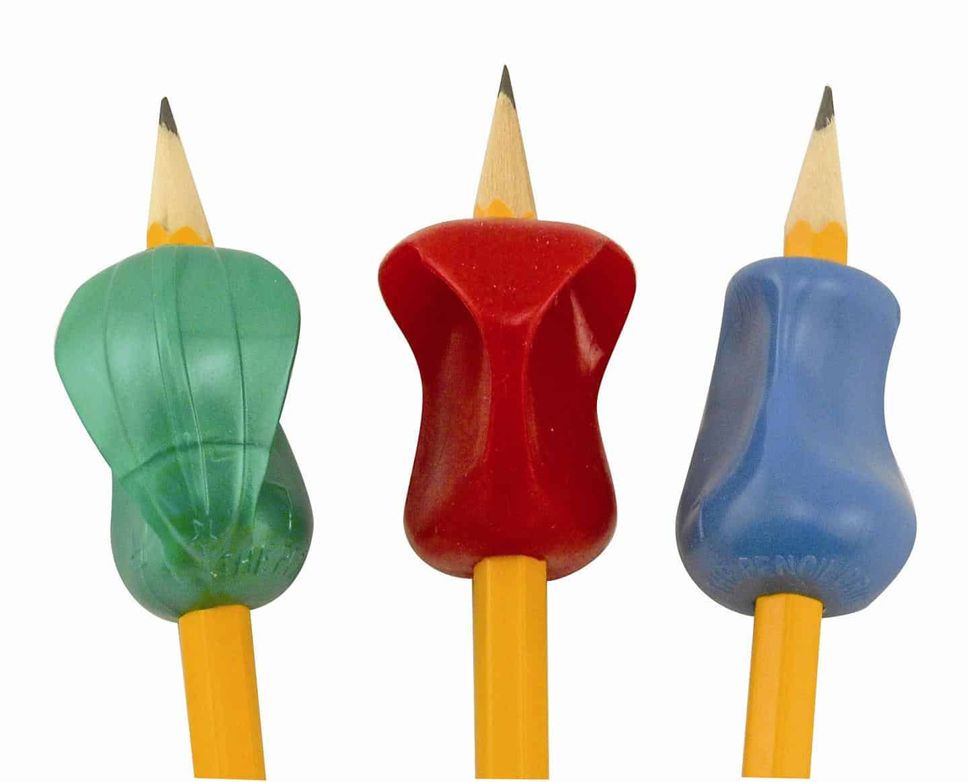
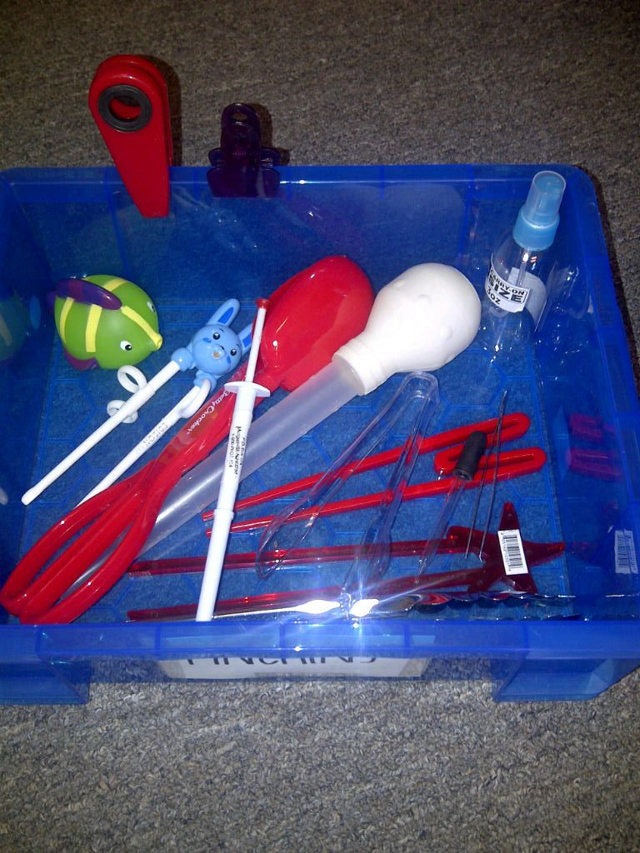

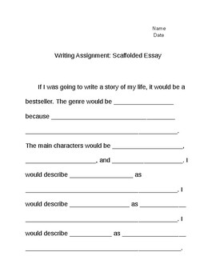

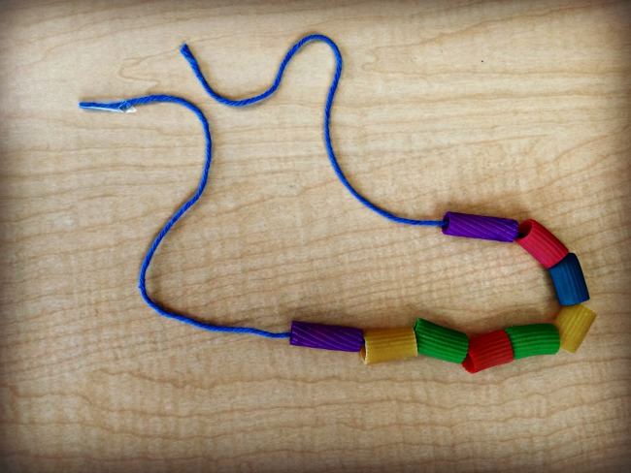

Fine Motor Deficits
Skill Builders
Pinching
Finger pushups
String games
Putty
Threading
Fastening
Accommodations
Pencil grip
Slant board
Provide notes
Scaffold writing
Cursive
Assistive technology

Slide 25
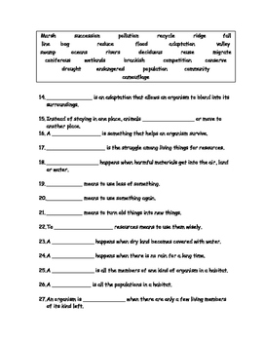
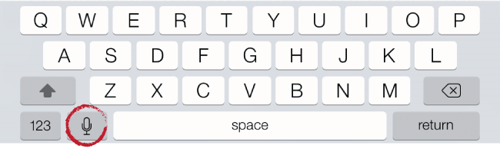
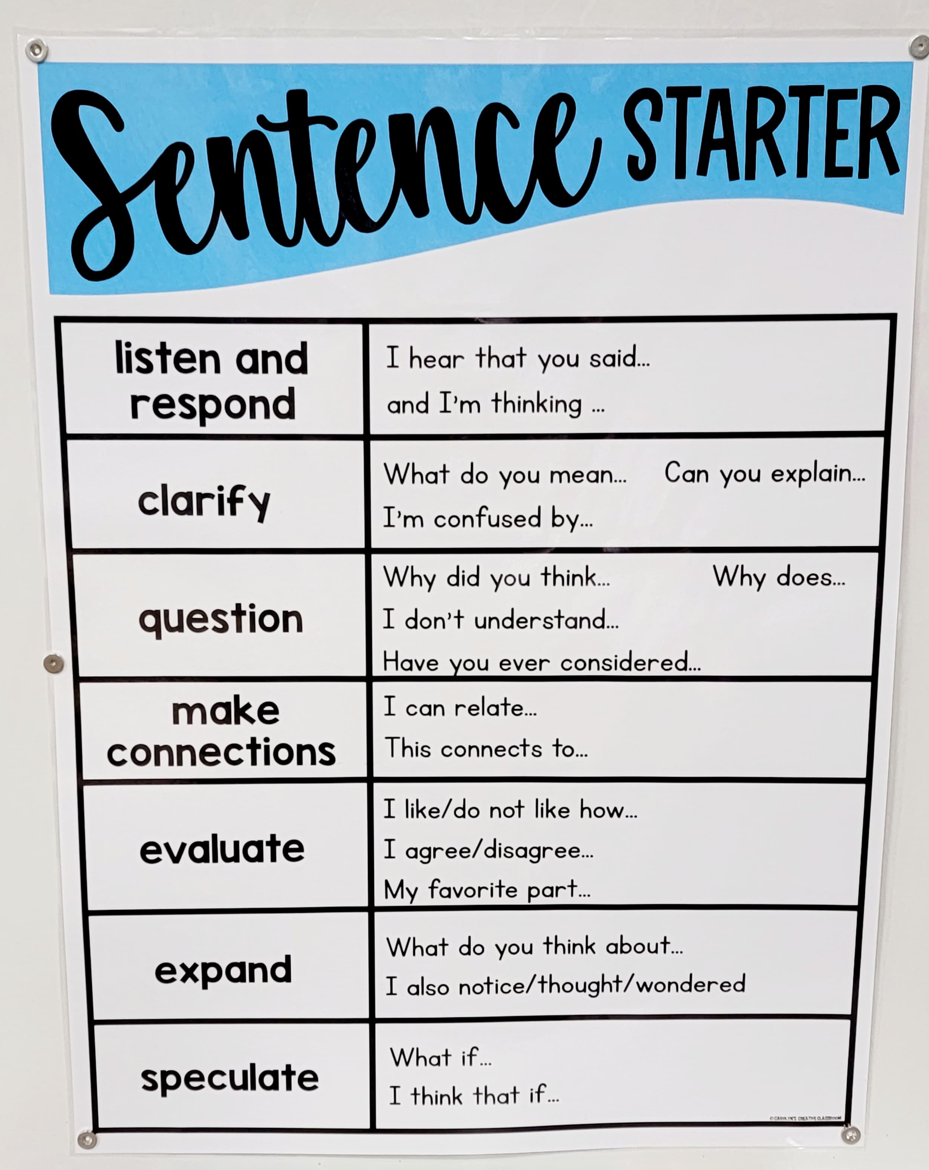
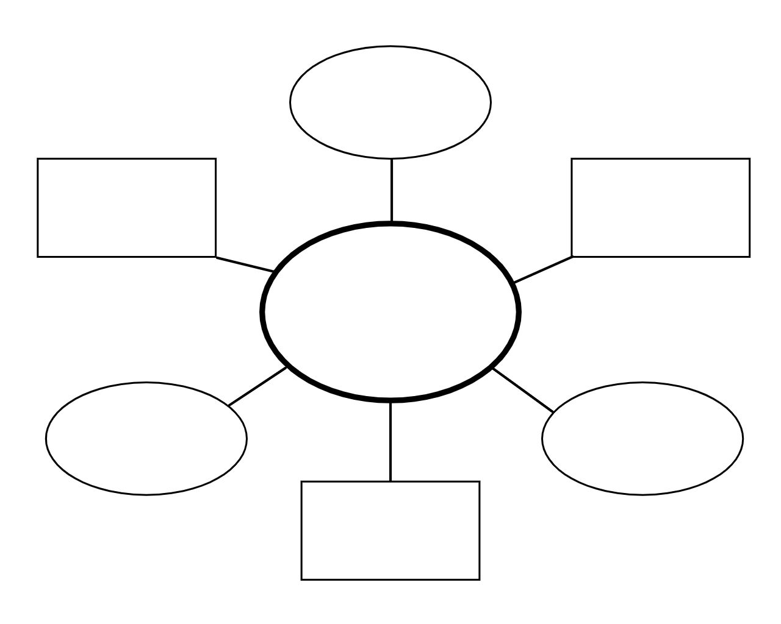
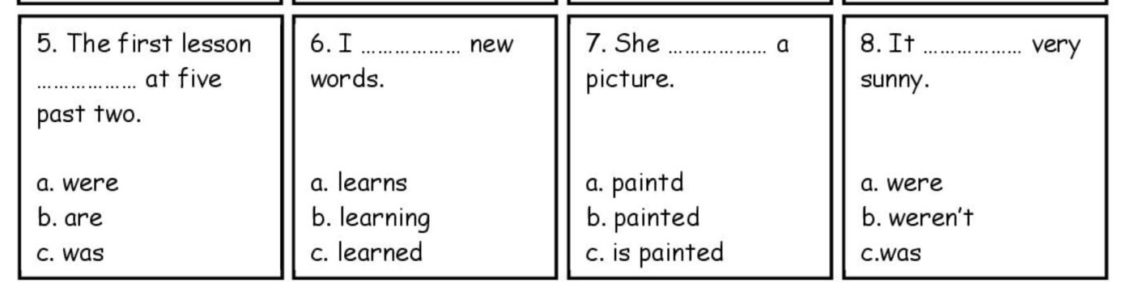
Language Processing
Skill Builders
Explicit instruction
Vocabulary practice
Build prior knowledge
Accommodations
Graphic organizers
Scaffolded essays
Sentence starters
Alternate formats
Assistive technology
Word banks

Slide 26
What exactly is dyslexia??
Dyslexia is a specific learning disability that is neurobiological in origin. It is characterized by difficulties with accurate and/or fluent word recognition and by poor spelling and decoding abilities. These difficulties typically result from a deficit in the phonological component of language that is often unexpected in relation to other cognitive abilities and the provision of effective classroom instruction. Secondary consequences may include problems in reading comprehension and reduced reading experience that can impede growth of vocabulary and background knowledge.

Slide 27

Dyslexia is…
Common
20%
Brain Based
Genetic

Slide 28
Dyslexia Vocabulary
Phoneme
Virgule
The slash marks around a letter or word that tell you to say the sound and not the letter/s
sh
/sh/
The smallest unit of sound
26 letters
44 phonemes

Slide 29
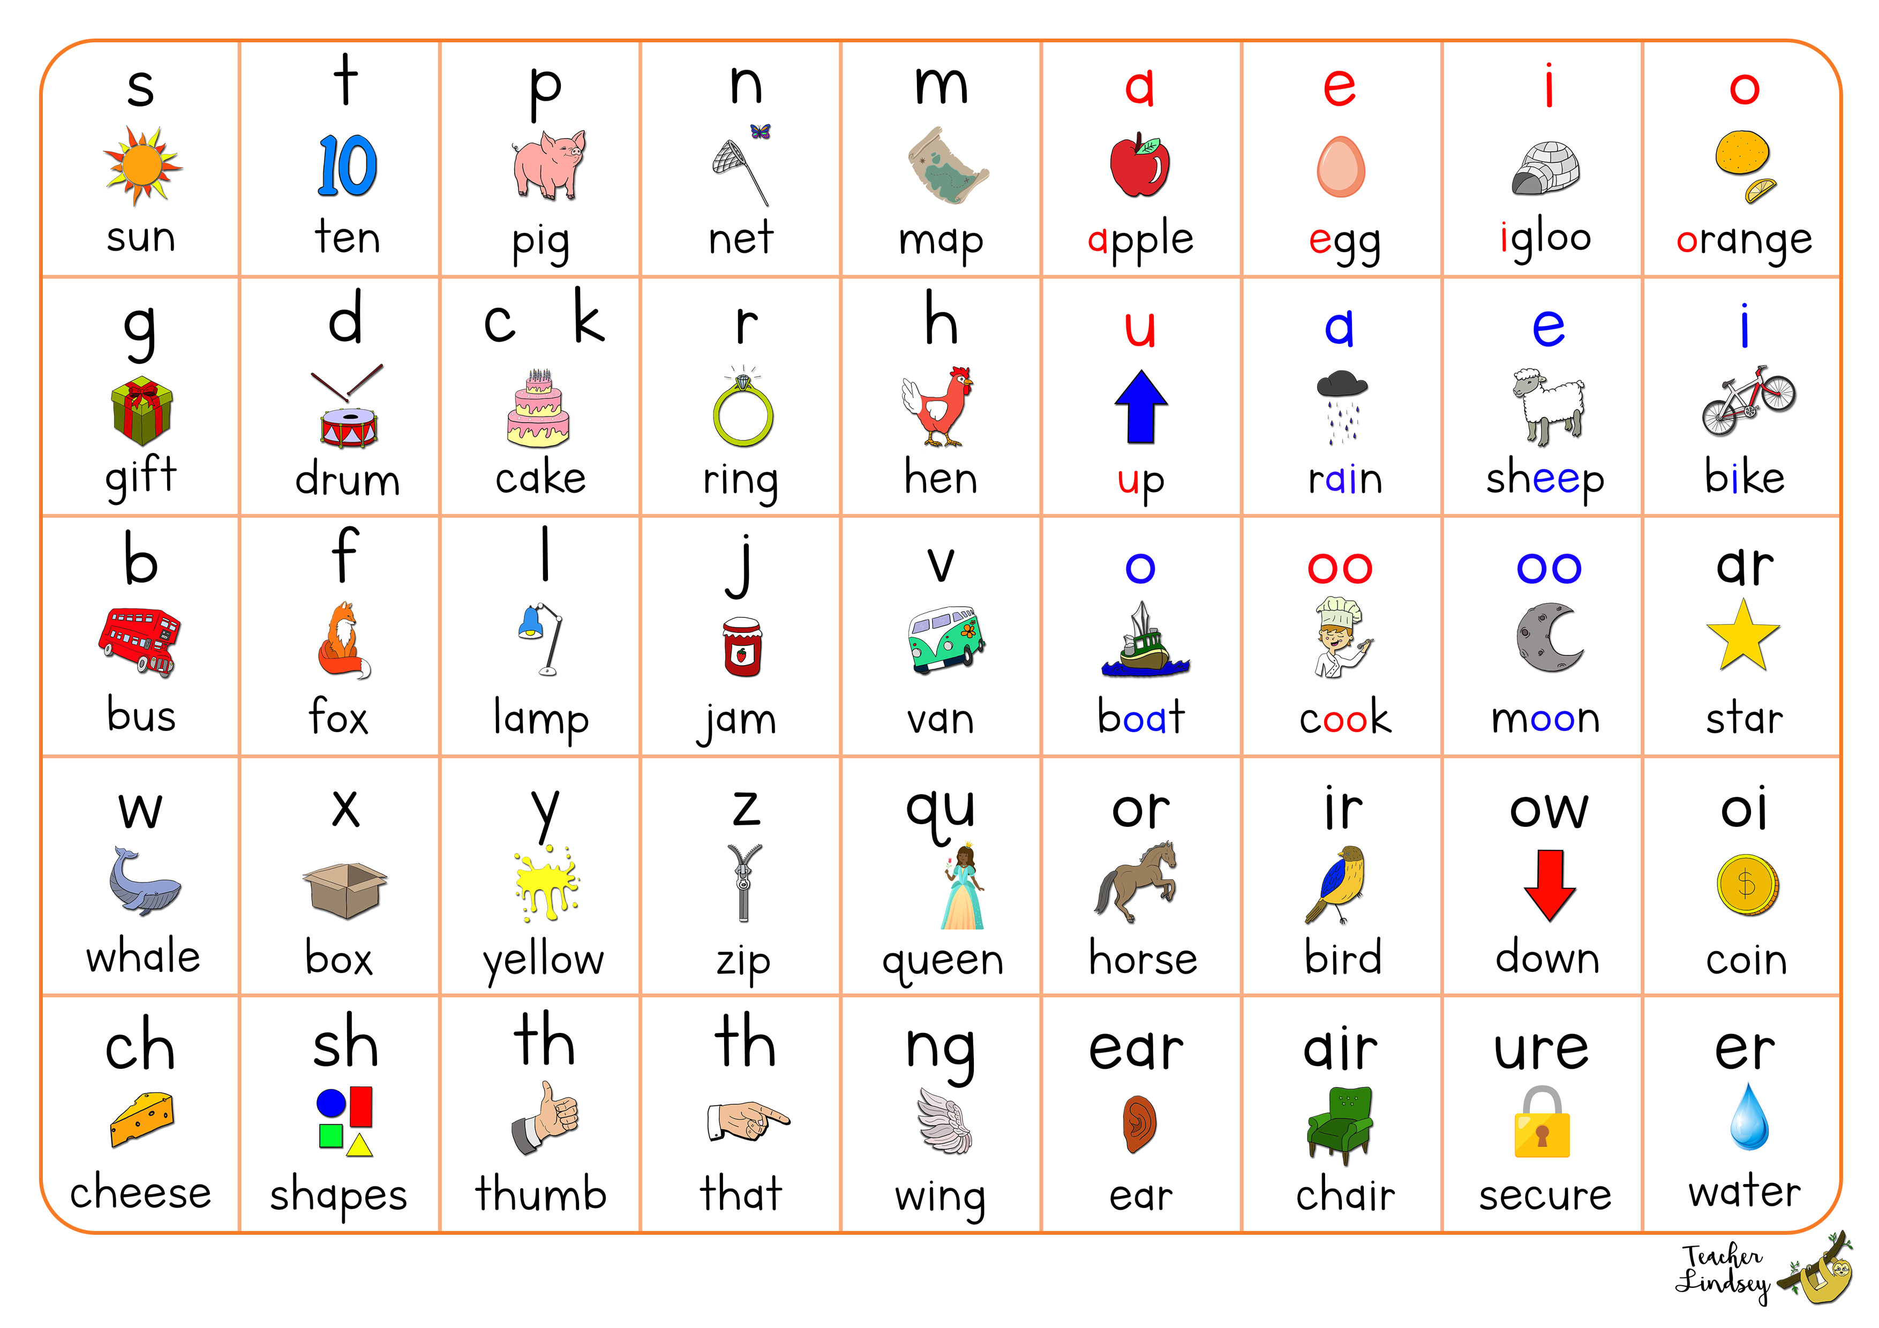

Slide 30
Dyslexia Vocabulary
Phonological Awareness
Phonemic Awareness
The ability to notice, reflect on and manipulate sounds of spoken words
rhyming
syllables
comparing words
phonemic awareness
The ability to notice, reflect on and manipulate individual sounds of within words
segmenting
blending
isolating
removing sounds (elision)
changing sounds

Slide 31
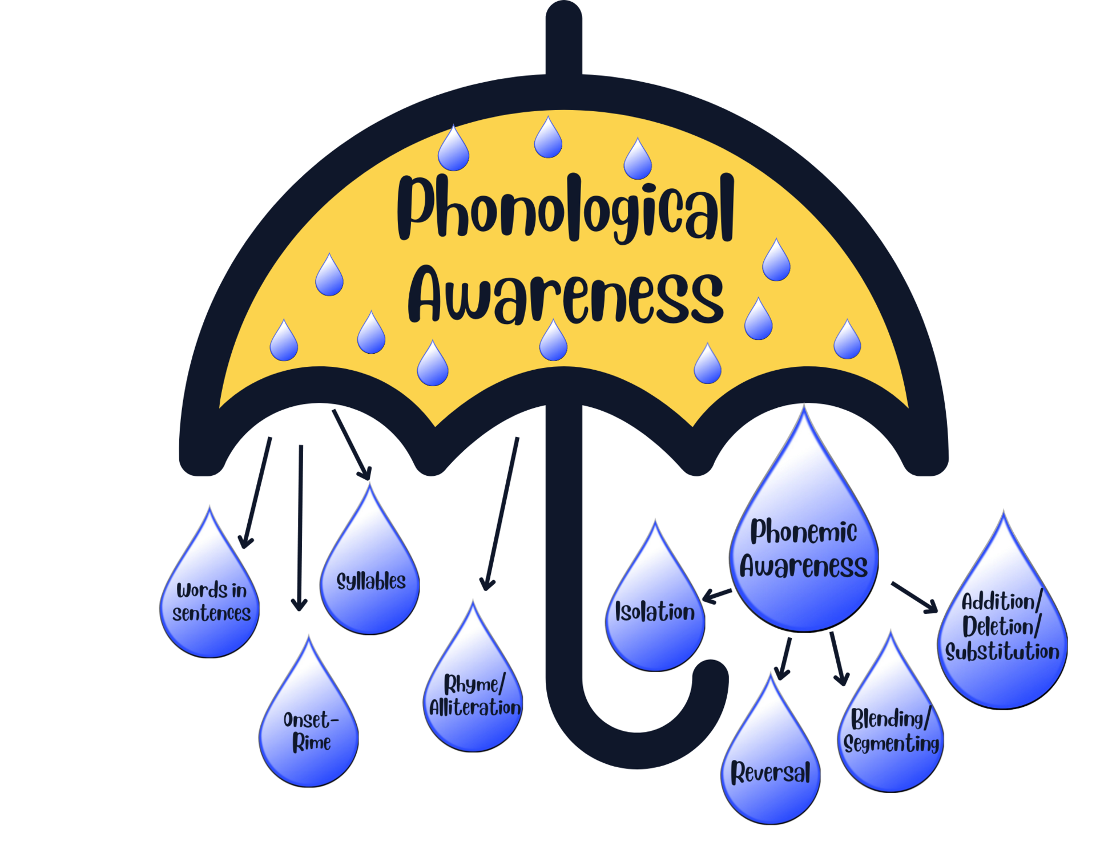

Slide 32
Dyslexia Vocabulary
Onset/Rime
Syllabication
Dividing words into syllables
Syllable TYPES and RULES
Explicitly taught
Onset is the initial consonant sound in a word
Rime is the ending chunk of a word
sink
Onset: s
Rime: ink

Slide 33
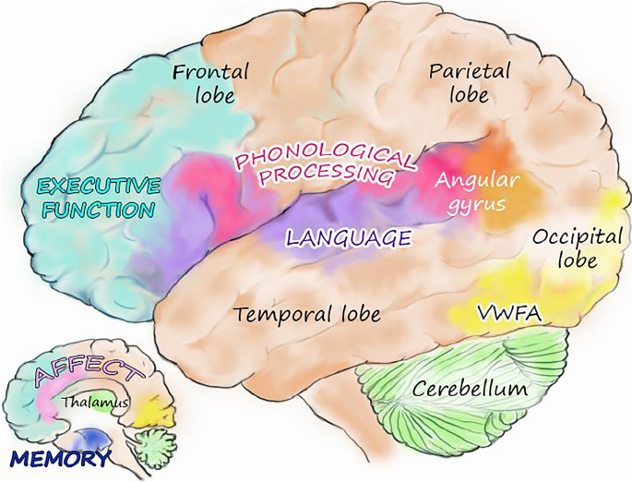
The Neurology of Language
The Human Brain: Biologically Wired for Oral Language​
The brain is biologically wired only for oral language—speaking, listening, and understanding—not for written language. There are no genes and no neurological or biological structures specific to reading and writing. To successfully read and write, each brain must “repurpose” regions biologically designed for other purposes and create new circuits and neural connections.
Wolf, M., Gotlieb, R.J.M., Kim, S.A. et al. Towards a dynamic, comprehensive conceptualization of dyslexia. Ann. of Dyslexia 74, 303–324 (2024). https://doi.org/10.1007/s11881-023-00297-1

Slide 34
Types of Dyslexia
Phonological Dyslexia
Surface/Visual/Orthographic Dyslexia
Rapid Naming Dyslexia
Double Deficit Dyslexia
Why does it matter?

Slide 35
Phonological Dyslexia
The most common type of dyslexia
Difficulty learning and processing sounds
Difficulty sounding out unfamiliar words
Difficulty blending, segmenting, isolating, identifying sounds
Difficulty spelling
Slow reading
Avoiding reading activities
Difficulty recognizing familiar words in new contexts

Slide 36

Visual/Surface/Orthographic Dyslexia
Visual
Orthographic
Difficulty with tracking words on the page
Visual processing difficulties with letters or words (p/q and b/d)
Surface
Difficulty with the visual/spelling structure of words
Struggle with letter sequencing
Poor spelling skills
Difficulty recognizing words by sight
Overreliance on “sounding out” words
Challenged by irregular words

Slide 37
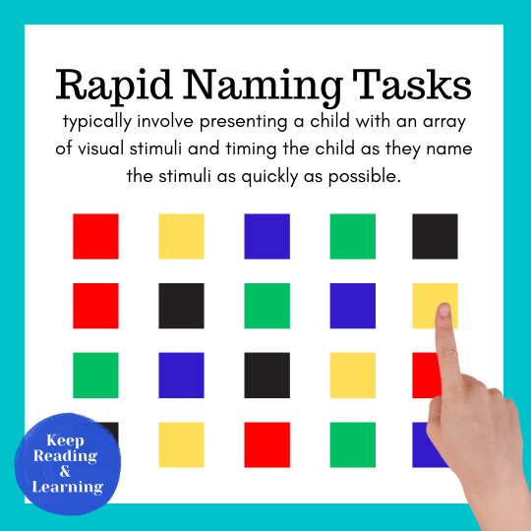
Rapid Naming Dyslexia OR Rapid Automatized Naming (RAN)
The ability to quickly name familiar objects
Affects fluency and word retrieval

Slide 38
Double Deficit Dyslexia
Any combination of the other Dyslexia types
Typically, most severe presentation of Dyslexia and requires more intervention and accommodations

Slide 39
Delays in speaking
Rhyming
Poor Auditory Memory
Vocabulary
Phonemic Awareness
Learning letters
Word Retrieval
Preschool Warning Signs

Slide 40
Slow, choppy reading
Reliance
on pictures/guessing
Difficulty breaking words into syllables
Difficulty sounding out words
Phonemic Awareness
Difficulty associating letters with sounds
Early Elementary Warning Signs (K-2)
Family History

Slide 41
Avoidance of reading
Guessing
Lacking word attack strategies
Can answer when read to
Written Expression
Uses less complicated words
Rhyming (poems)
Elementary Warning Signs (3-5)

Slide 42
Avoidance of reading
Skips over words
Volume
of reading and writing
Foreign Language
Written Expression
Prefers multiple choice
Middle/HS Warning Signs (6-12)
Frustration

Slide 43
Screenings
Purpose: Predict Risk
Universal
Specific
Given to all students
Analyze results
If students fall in the “at risk” or below category – move to a Dyslexia Screener
Want to catch “at risk” students early
Intervene
Do not “wait to fail”

Slide 44



Diagnosing Dyslexia
Oral Language
Phonological Processing
Decoding
Fluency
Comprehension
Spelling
Vocabulary
Data collection from parents and school
Neuropsychologist or clinical psychologist
State eligibility for Specific Learning Disability
“characteristics of Dyslexia”

Slide 45

Vocab Check
Accommodation: is a change to how students learn and offer support to account for challenges. They don’t change what students learn in school.
Modification: is a change to what a student is taught or expected to do in school.
Interventions: additional instruction that supplements the general curriculum and may include supports outside of the regular classroom (i.e. pull-out for small group instruction) necessary to improve academic performance.
Notes:
ANY teacher can provide an ACCOMMODATION to ANY student!
It becomes data to consider in the future if needed! May help a student through a rough spot!

Slide 46
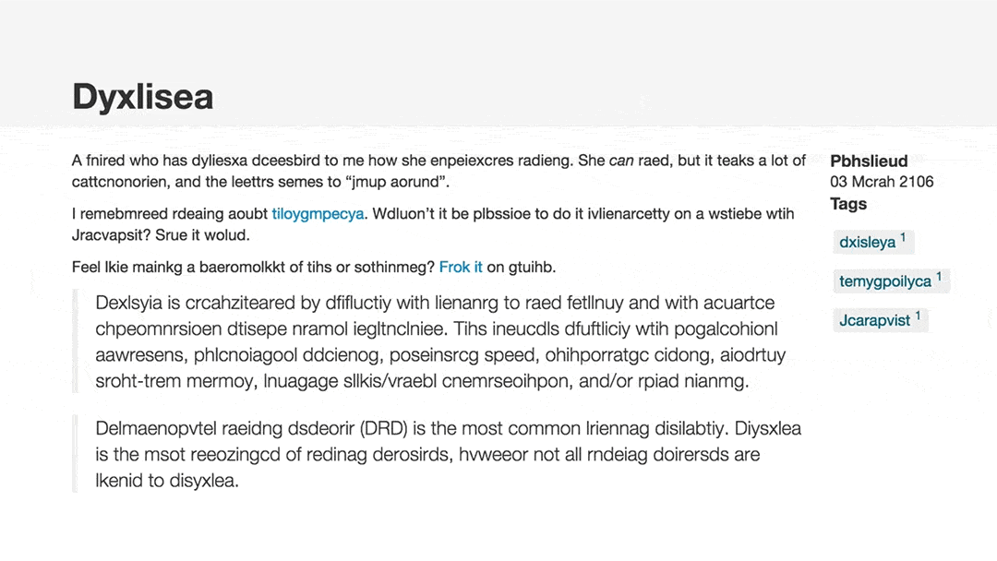

Slide 47
Waive Foreign language
*ASL*
Access to Technology
Speech to Text
Text to Speech
Audiobooks
Extra Time
Visual Aids Graphic Organizers
Provide copy of notes
Alternate forms of expression verbal
Multiple choice
Grading expectations
Dyslexia Accommodations

Slide 48
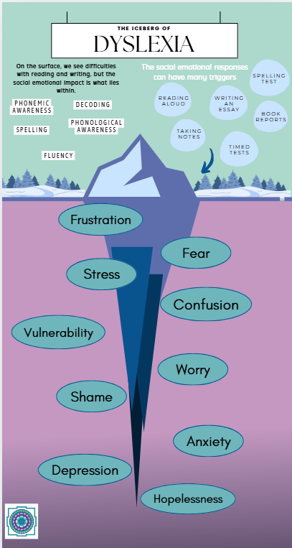


Slide 49

Extra Time
Must not be Punitive
Something has to give – usually reduction in workload
Eliminate time barrier
Allow assignments late without penalty
Cognitive Load
The brain is working harder and will fatigue. The amount of energy it takes to read or write is higher
Standardized Assessments
Should be written into a plan for any standardized assessment, especially college entrance exams
Why?
Scenic route
Slower decoding
Will naturally take longer to read or write

Slide 50
Waiving Foreign Language
American Sign Language
Learning a foreign language requires an understanding of how the native language works
Cognitive Load
Exposure and expectations

Slide 51
Assistive Technology
Audiobooks
Apps
Speech to Text Text to Speech
Grammarly
Speechify
SnapType
Ghotit
Allows access to the same content without the pressure of decoding
Learning Ally
Bookshare
Audible
Converts spoken word into text and vice/versa
Google/Microsoft Extensions
Dragon
Natural Reader
Pen Readers

Slide 52



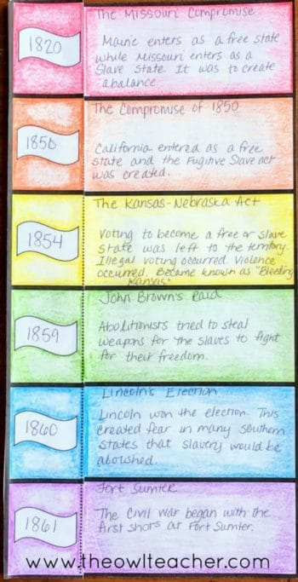
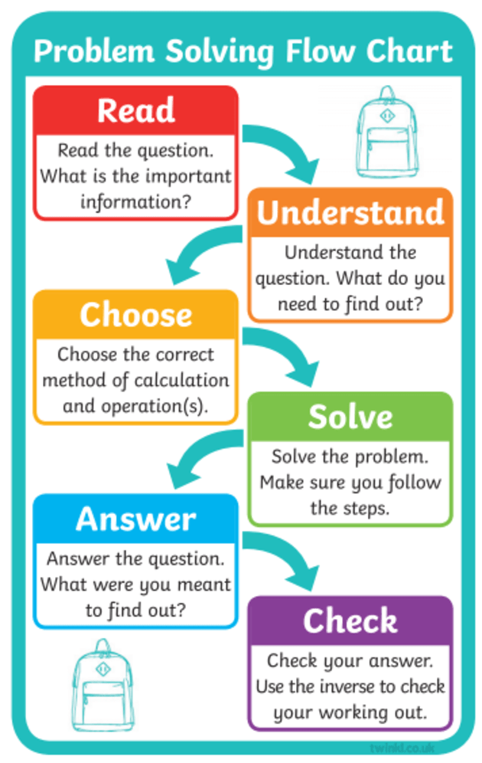
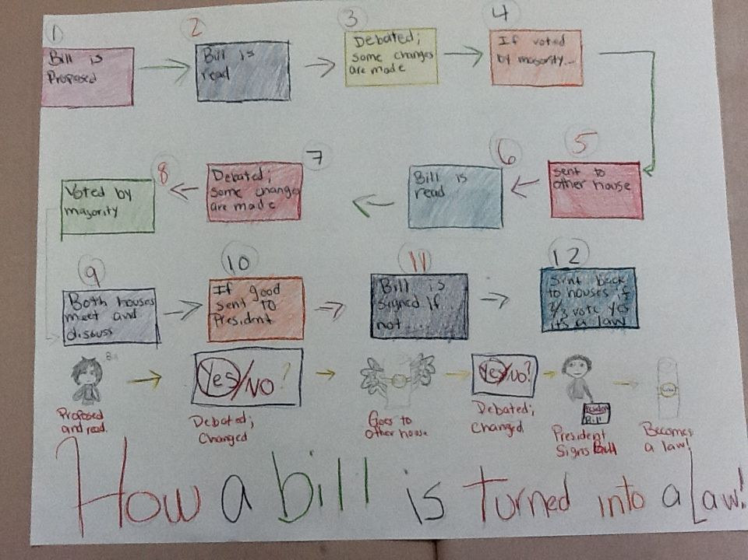
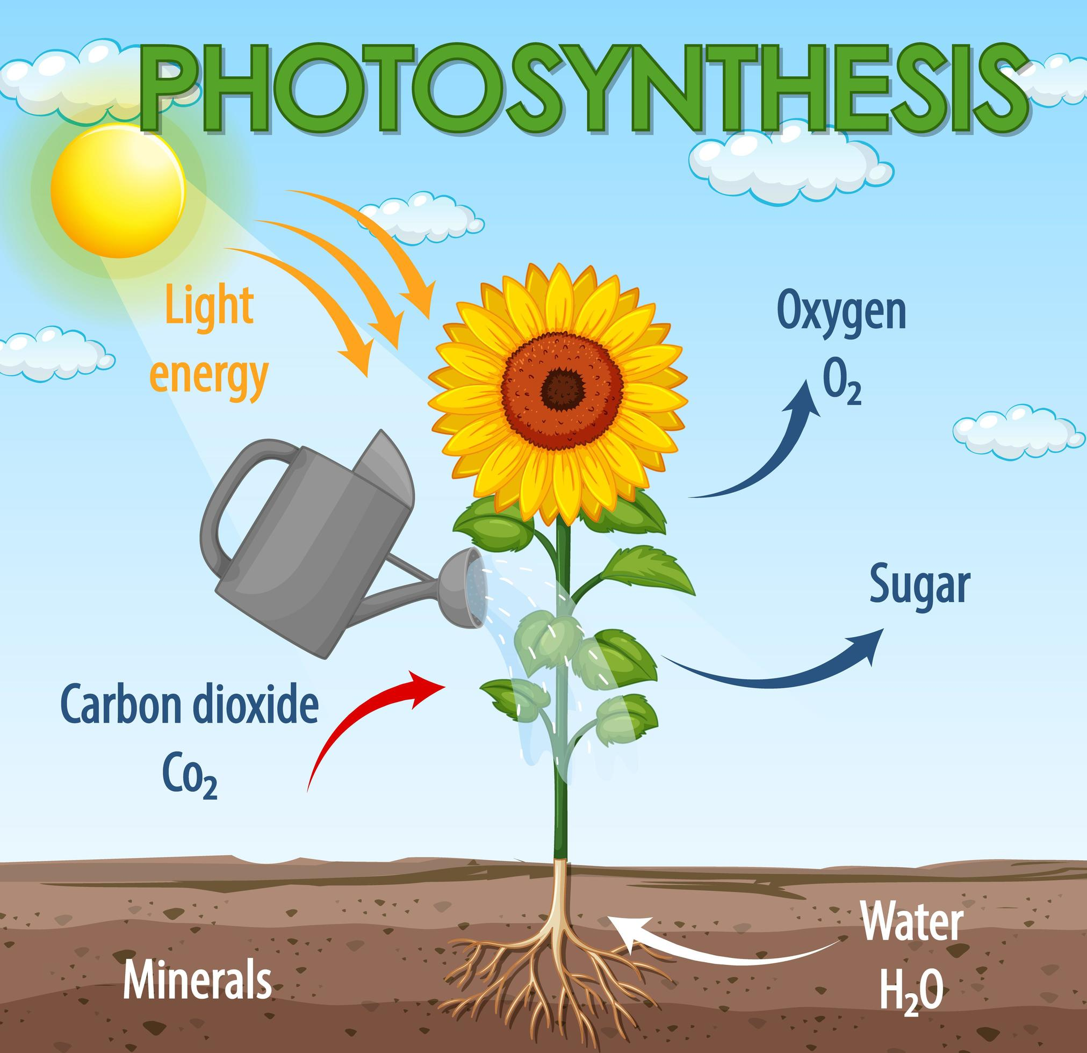
Dual Coding Theory
Verbal + Nonverbal = Optimal
Output (Expressive)
Draw diagram
Comic Strip
Illustrations
Timeline
Input (Receptive)
Diagram – Photosynthesis
Flowchart – problem solving
Images – vocabulary
Picture Sequences

Slide 53
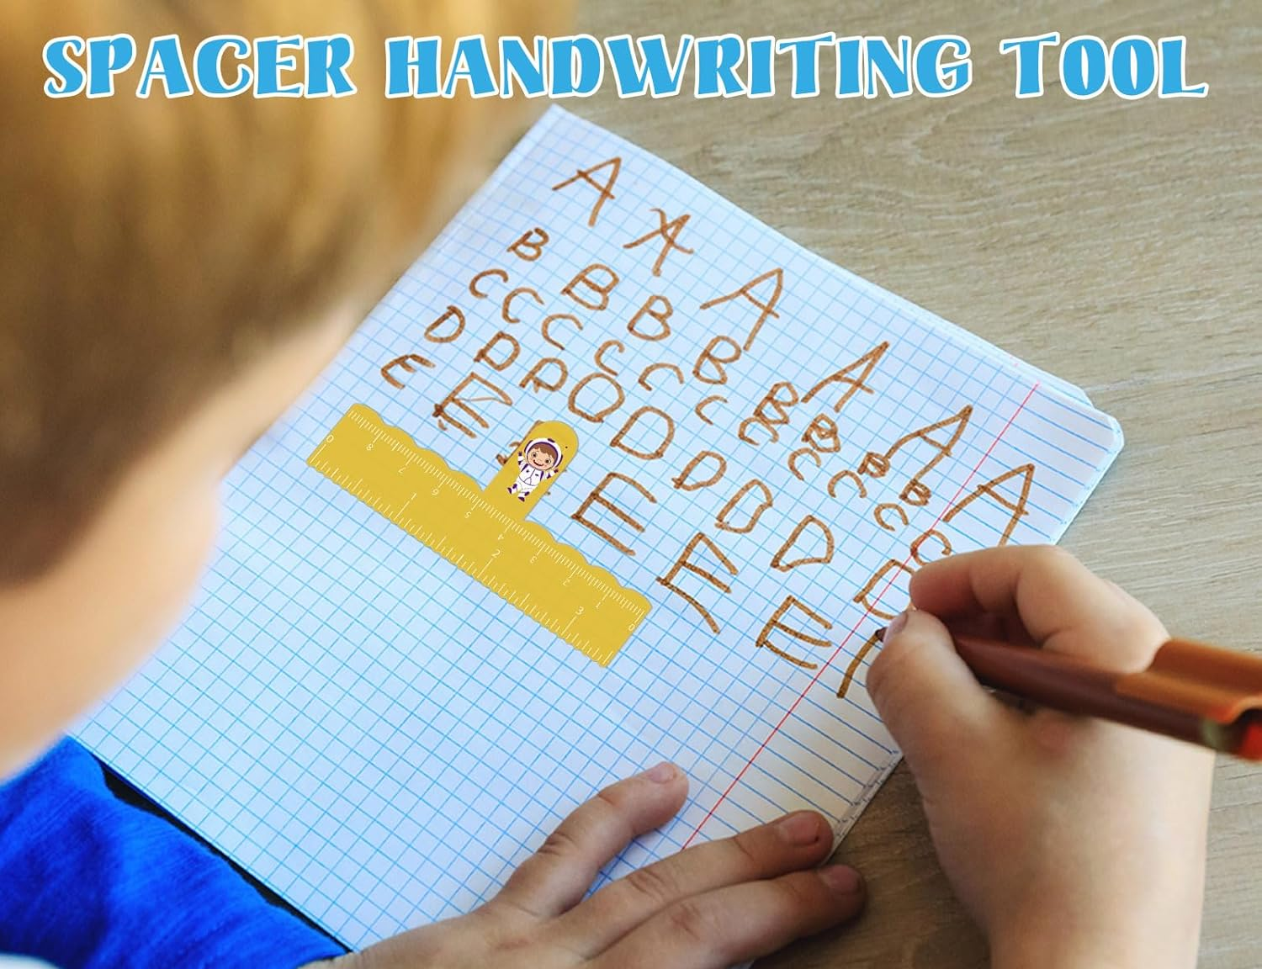
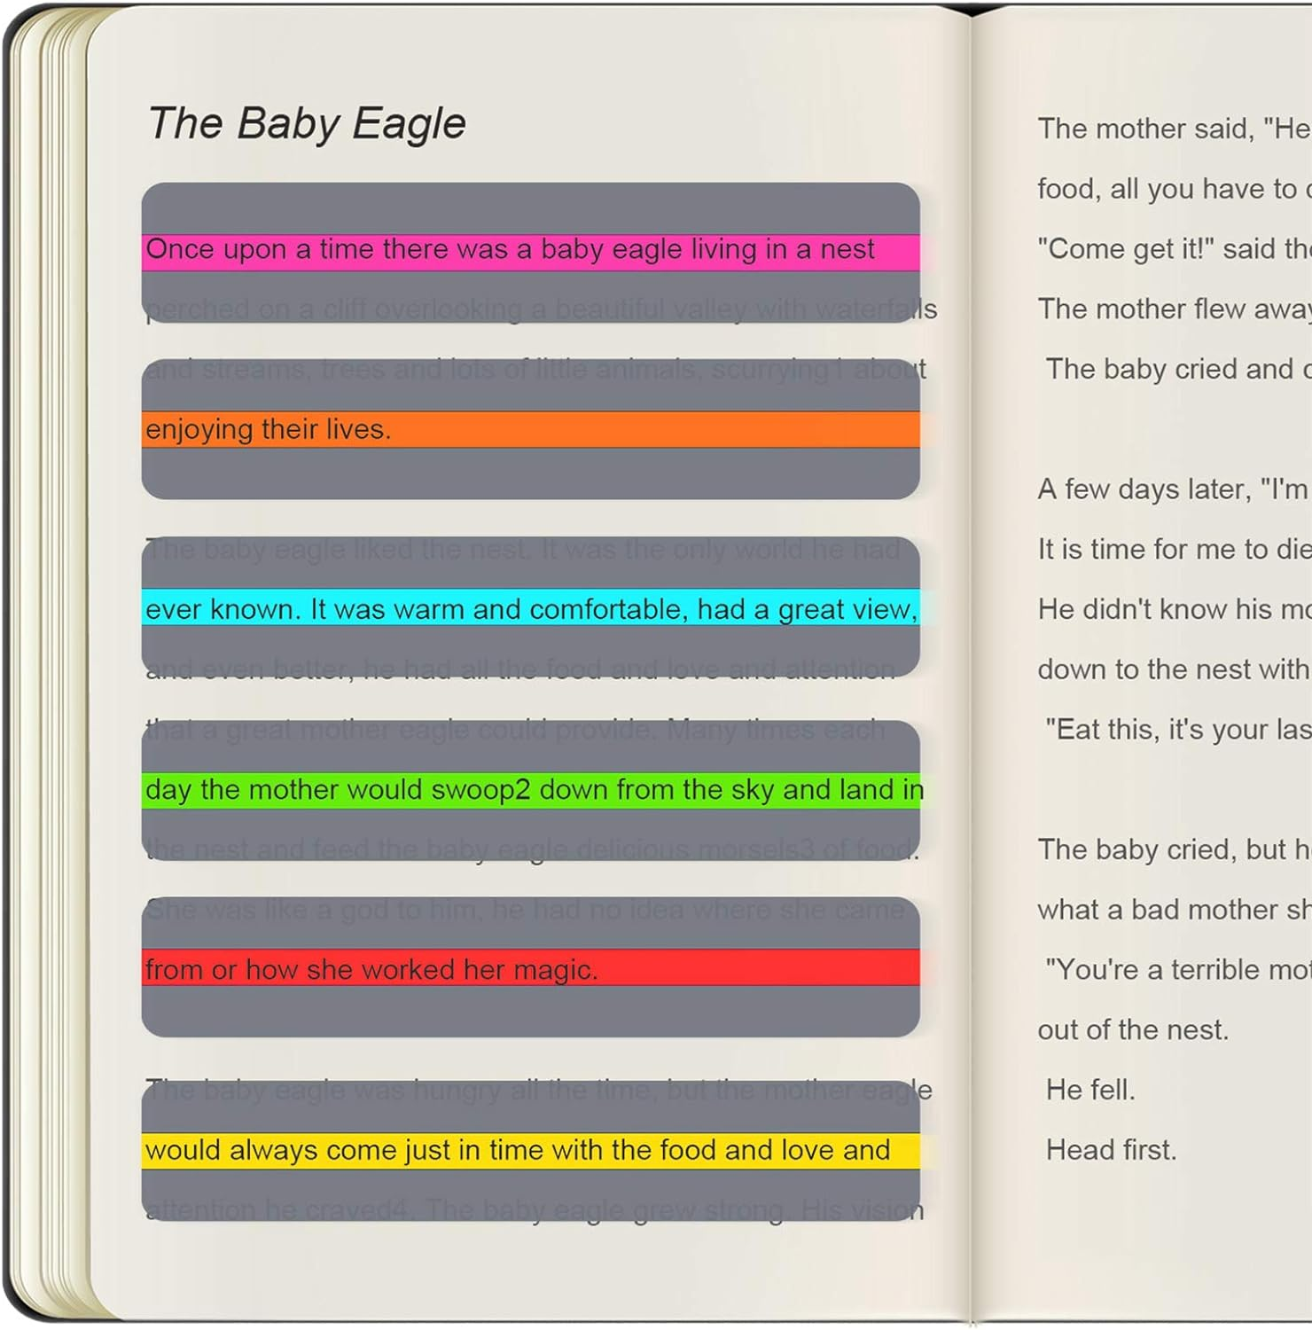

Highlighter Strips
Visual Trackers
Window Tracker

Slide 54
Note Taking Accommodations
Why?
Scaffolded Copy
Provided copy
Difficulty with tracking words on the page
Fluency of writing
Impedes active listening
Copy of the notes with words missing that you want the child to fill in
Template
Teacher notes
Reliable peer notes
Active process
Highlight key phrases or draw pictures

Slide 55

Flexible assessments
Align grades to Standards
Change expectations on grades, especially for spelling and grammar on non-spelling tasks

Slide 56

Engagement
Flexible grouping
Identifying strengths
Center/stations
Creating a Dyslexia Friendly Learning Environment
Representation
Visual paired with auditory
Assistive technology
Multisensory
Raise your hand if you are familiar with UDL
Expression
Text to speech
Graphic organizers
Multiple choice
Illustrations

Slide 57


The Science of Reading
National Center on Improving Literacy

Slide 58
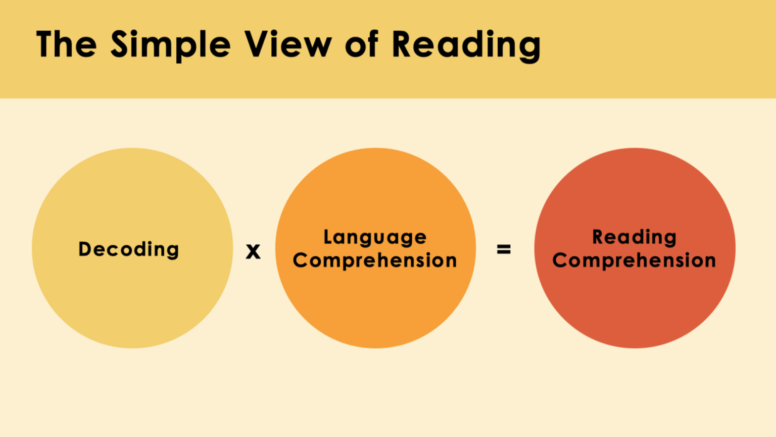

Slide 59
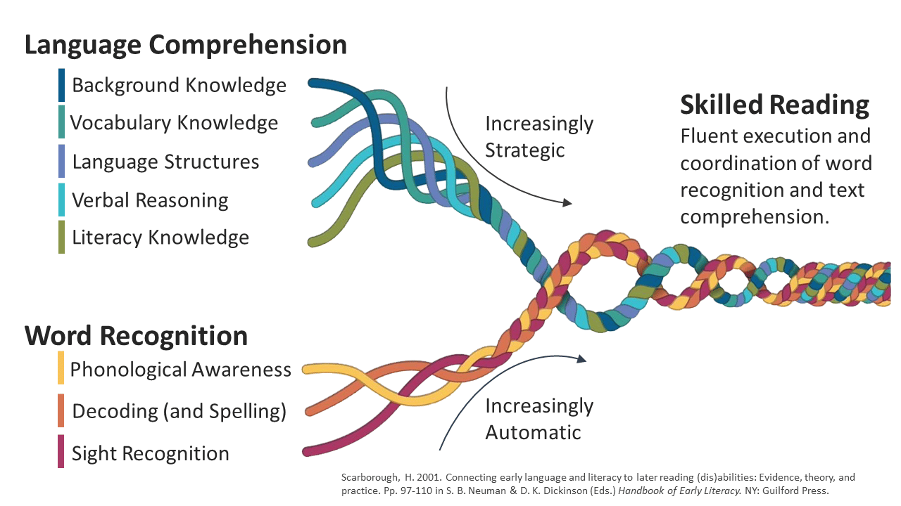

Slide 60
“Wait to Fail” model is too late
Neural pathways become strengthened over time
The sooner we can “rewire”, the better
Move from learning to read to reading to learn
Close the gaps earlier
Confidence increases, avoidance decreases
Self Esteem rises
Early
Intervention

Slide 61
Explicit
Orton Gillingham:
Structured
Evidence Based
approach to teaching literacy
Systematic
Multisensory

Slide 62
Explicit Instruction
Direct
Modeled and Practiced
Feedback and Correction
Clear
Intentional
Leaves no room for ambiguity, guessing, or implied prior knowledge
Teacher gives specific feedback
Make corrections immediately
Practice again
Teacher demonstrates, child watches, then practices

Slide 63
Systematic
Sequential
Use baseline data
Follow prescribed sequence
Step by step
Mastery
Frequent progress monitoring
Review and adapt
Build foundational skills

Slide 64
Links
High Leverage Practices
App Wheel
Dyscalculia
Subitizing
Panamath
Math Running Records
Lord Math
Mahesh Sharma
Brian Butterworth
Chris Woodin
Ann Elise Record
RTI Math - What Works
Word Problem Instruction
Dysgraphia
What is Dysgraphia
Understanding Dysgraphia
Dysgraphia Treatment
Fine Motor Exercises
Visual Spatial Freebies
Dyslexia
What is Dyslexia?
Classroom Accommodations
Science of Reading
Int’l Dyslexia Association
PAST Screener
Orton Gillingham
Understanding Dyslexia

Slide 65
Did we meet the goal?
Participants will learn the components of Dyscalculia, Dysgraphia, and Dyslexia
Participants will attain practical strategies and accommodations to use in their classrooms
The clock hour code for your session is: M5N-4W7

Slide 66

Keep in Touch!
sue.milano@inclusionsolutions4kids.com
https://inclusionsolutions4kids.com
Twitter/X
@inclusion4kids
@sue_milano
@crystalbrooksaz
@cmccejka

